Slide 1
Aid Effectiveness in Africa
African Union Commission
Department of Economic Affairs
November 24 , 2011
By Lulit Bereda

Slide 2
Outline
Aid effectiveness defined
Aid figures in Africa
Where does the aid go ?
Reflection on aid effectiveness
What is being done to bring Aid effectiveness ?
Plan of actions
Has these plan of action been effective ?
Solutions

Slide 3
Aid effectiveness defined
Aid effectiveness is defined as the effectiveness of development aid in achieving the economic, social and human development targets set out by both donors and recipients.

Slide 4
Aid effectiveness defined
is the impact that aid has in
Reducing poverty and inequality,
Increasing growth and building capacity
And accelerating achievement of the Millennium Development Goals set by the international community.

Slide 5
Aid figures in Africa
Net ODA and population of aid recipient
in USD countries by region in 2009
 | Net ODA USD million
Africa | 47,609
Asia | 38,333
America | 9,089
Europe | 5,788
Oceania | 1,647
Unspecified region | 25,060
All ODA recipients | 127,527
In 2009, the net bilateral Official development Assistance (ODA) to Africa was USD 47,609 billion while USD 24 billion of this aid went to sub-Saharan Africa.

Slide 6
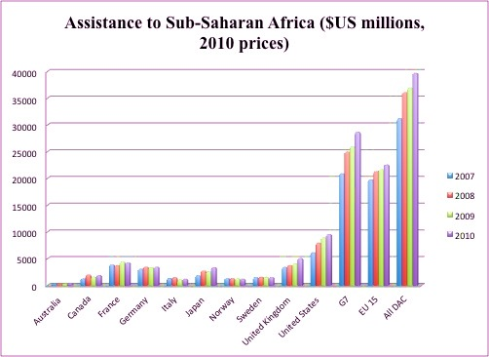
Assistance to Sub-Saharan Africa ($US millions, 2010 prices)
Source : One Data report 2011

Slide 7
Aid figures continued
In 2009, the largest donors by volume were the
United States,
France,
Germany,
the United Kingdom
and Japan.
Five countries exceeded the United Nations ODA target of 0.7% of GNI: Denmark, Luxembourg, the Netherlands, Norway and Sweden.

Slide 8
Aid figures continued
Also, In 2009, while some donor countries increased their net ODA, other countries cut their Aid budget due to the current global crisis.
Belgium ( 11.5 %)
Denmark (4.2 %)
France ( 16.9 %)
UK ( 14.6 %)
Greece ( 12 % )
Italy (31.1 %)
Portugal ( 15.7 % )
Spain (1.2 %)
Source : OECD Aid Statistics

Slide 9
Aid figures continued
The largest recipient of net official development assistance (ODA) in Sub-Saharan Africa received an amount 165 times larger than the smallest recipient.
The largest recipient is Cape Verde, and the smallest is Seychelles.

Slide 10
Where does the Aid go ?
Official development assistance (ODA) is a term coined by the Development Assistance Committee to measure aid. The goals of ODA is to
Drive sustainable economic growth and development
Promote Democratic governance
Improve social services such as health and education
Provide Humanitarian Aid
Mitigate and manage conflicts etc…

Slide 11
Reflections on Aid Effectiveness
Problems facing aid effectiveness
lack of differentiation between the different types of aid.
Short term Vs. long term aid
Argument: short-term aid does not have an impact on economic growth while other aids used for infrastructure and investments will result in a positive economic growth.

Slide 12
Reflections on Aid Effectiveness continued
2. The misappropriation of Aid to corrupt and undemocratic governments of recipients countries.
Argument : the anticorruption field and movement has not been able to effectively transition from the awareness-raising stage to the concrete action-oriented stage that will eliminate the systemic problem.

Slide 14
Reflections on Aid Effectiveness continued
3. The lack of good economic policies and institutions in recipient countries result in the ineffectiveness of aid.
Argument: Aid is only effective in countries with “sound” policies and institutions and is ineffective in poor countries lacking them. (World Bank, Burnside and Dollar, 2000)

Slide 15
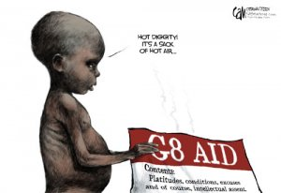
“When Aid is ineffective”

Slide 16
Reflections on Aid Effectiveness continued
4. Ineffective policies implemented both by donor and recipient countries.
Argument : Aid has tended to support domestic policy reform efforts of recipient countries while narrow political objectives of donors still play a dominant role in many aid decisions today.

Slide 17
Reflections on Aid Effectiveness continued
5. Donor governments that cut back on their promised responsibilities.
Argument : In 1970, the world’s rich countries agreed to give 0.7% of their GNI as ODA annually. Since that time, despite billions given each year, rich nations have rarely met their actual promised targets resulting in lack of financing for development plans .
For example, the US is often the largest donor in dollar terms, but ranks amongst the lowest in terms of meeting the stated 0.7% target.

Slide 18
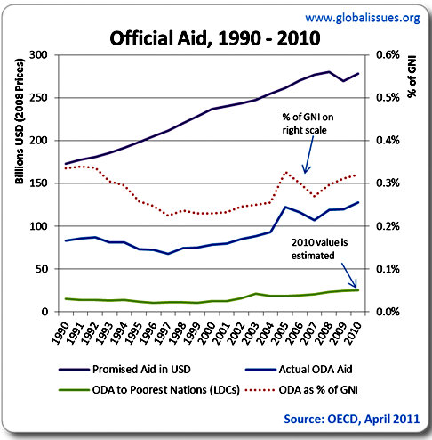
Promised Aid Vs. Actual Aid

Slide 19
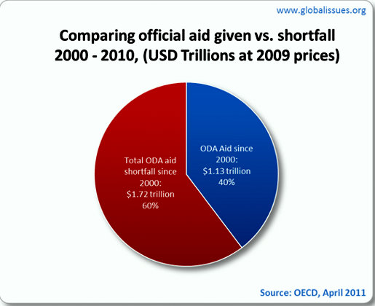

Slide 20
What is being done to bring Aid effectiveness ?
International aid did not manage to effectively alleviate poverty in the world so countries got together to address the problem in three high- level forums.
Rome Summit (2003)
Paris declaration (2005)
Accra Agenda of action (2008)

Slide 21
Plan of actions
In these high level forums , countries agreed on five principles to increase aid effectiveness.
Ownership by the developing countries
Harmonization among donors
Alignment of the aid to institutions and procedures of the developing countries,
Mutual accountability
Management for results.

Slide 22
Has these plan of action been effective ?
A report by the UN Secretary General accurately assessed the situation: “The Paris process has not demonstrated genuine ability to change donor behavior or to link the aid-effectiveness agenda with sustainable development results.”
“We are making progress, but not enough” (Accra Agenda for Action).

Slide 23
Solutions
The principles agreed upon in the high level forums need to respected
governments on both sides must actively strive for aid effectiveness and commit to their partnership
“Governments in developing countries must have more than just a say in development matters – they must take the lead”.
In order to finally see real progress, a period of compliance should be agreed upon, during which all necessary changes need to happen.

Slide 24
The End
African Union Commission

