Slide 4
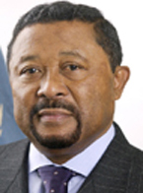
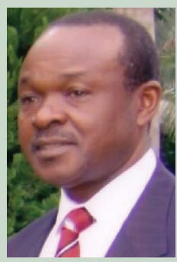
Together, let’s navigate the FUTURE... NOW!
www.AU.int/Maritime
…Swim with us on
&
Arabic, English, French, Kiswahili and Portuguese.

