Slide 1
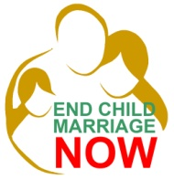
AU CAMPAIGN TO END CHILD MARRIAGE IN AFRICA

Slide 2
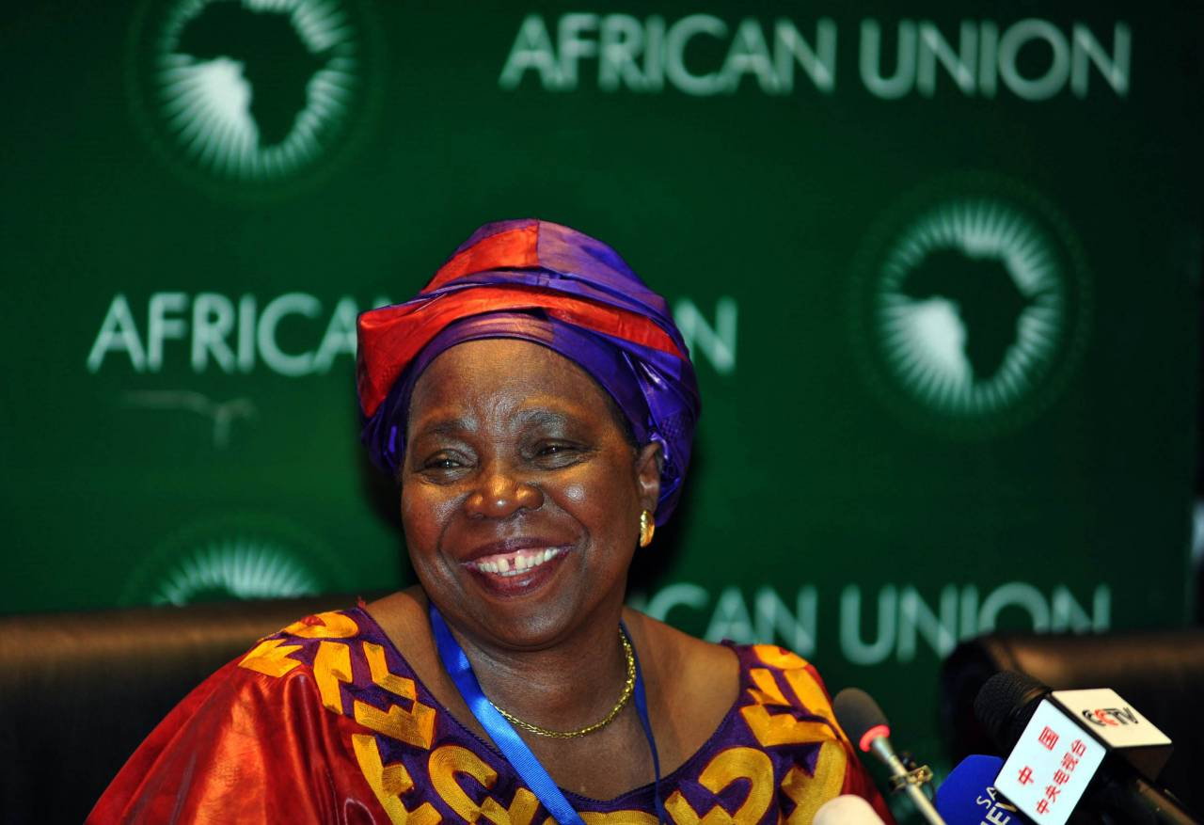
“We must do away with child marriage. Girls who end up as brides at a tender age are coerced into having children while they are children themselves.”
Dr. Nkosazana Dlamini-Zuma, Chairperson, AUC at the International Conference on Family Planning, Addis Ababa, November 2013

Slide 3
BACKGROUND
Child marriage defined as: a formal marriage or informal union before age 18.
Or “any marriage carried out below the age of 18 years, before the girl is physically, physiologically, and psychologically ready to shoulder the responsibilities of marriage and childbearing

Slide 4
Child marriage has devastating and long term effects ( health, education, psychological, emotional, mental etc.) on the life and the future of girls. It is a human rights, gender, health and culture, as well as a development issue.

Slide 5
Causes and effects of Child Marriage in Africa
Causes:
Poverty
Discriminatory Cultural and Religious Traditions
lack of political engagement
Effects :
poverty
ignorance (lack of education)
health problem
human rights violation

Slide 6
CHILD MARRIAGE
POVERTY
SOCIETY AND CULTURE
NO POLITICAL ENGAGEMENT
No access to education
Failing policies + no infrastructure + lack of mobilization
Parents wants to get financial gain in form of dowry
Daughter = economic burden.
Perpetuating
+ Traditions; protect daughter’s virginity and chastity; alliances between tribes, clans and villages
Policies
Law and codes

Slide 7
Limiting girls affects a country’s human capital In a World Bank report of August 2011- ‘Measuring the Economic Gain of Investing in Girls: The Girl Effect Dividend’ by Jad Chaaban and Wendy Cunningham: This paper builds on the methodology developed in World Bank (2003) to generate the economic costs of girls’ and young women’s exclusion in terms of early school dropout, joblessness, and pregnancy. The cost estimates measure the consequences of the depletion of human capital, as young girls who do not develop their potential, or whose human capital is constrained, necessarily limit their productive contribution to the economy.

Slide 8
Children in conflict zones are at even greater risk, these children are forced into conflict due to poverty, sold by their parents, kidnapped, or tricked into joining.
Since these children are most often unaccounted for due to disintegration of family units and other relatives, they have no help or support system and are helpless to be exploited an abused.

Slide 9
In addition, it is imperative to also mention the importance of birth registration to the protection of children from child marriage:
Lack of birth registration services makes it difficult to determine the exact age of children for purposes of legal protection. (ACPF)

Slide 10
AU Campaign to End Child Marriage

Slide 11
Child marriage as mentioned is a human rights violation has been included in a number of legal instruments at the continental and international levels. The African Charter on the Rights and Welfare of the Child (ACRWC) defines a child as a person under the age of 18 years, and the African Youth Charter defines a minor as a person between the ages of 15-17. Also international instruments such as CEDAW, CRC, Universal Declaration of Human Rights

Slide 12
The AU specifically promotes policies related to young peoples’ rights and is mandated by its various instruments with a
bearing on the rights of children and youth to promote common standards .
by supporting adaptation
and implementation of the instruments at regional and national level and monitoring of implementation progress by Member States and ensuring accountability.

Slide 13
The AU campaign will initially run for two years Building on already existing activities and work by the above partners in ending child marriage .
Advocacy
Monitoring and Evaluation (M&E)
Facilitation of Technical Assistance and Capacity Building

Slide 14
Given the socio-economic and cultural context within which child marriage occurs, the project will aim at :
Mobilizing continental awareness of child marriage
Increasing the capacity of non-state actors to undertake evidence based policy advocacy including the role of youth leadership through new media technology, monitoring and evaluation among others.
Ending child marriage by supporting policy action in the protection and promotion of human rights
Promoting the effective implementation of AU legal and policy instruments with a bearing on young people especially the girl-child
Removing barriers and bottlenecks to law enforcement ( taking into account the reality of protection already accorded by the law in different countries
Determining the socio-economic impact of child marriage;

Slide 15
The overall expected outcome will be: The end of child marriage in Africa accelerated
The main results are:
Demonstrated reduction in the rate of child marriage by end of 2015, particularly in countries where the campaign to end child marriage has been launched.
Increased numbers of countries that review, enact, and enforce the necessary legislation in line with regional and international regarding child marriage.
Increased percentage of adolescents with access to sexual and reproductive health services particularly in countries where the campaign to end child marriage has been launched.

Slide 16
Follow-up Activities after the country launches:
Capacity building and training workshops on child marriage for Member States at regional level
Prepare and disseminate M&E Framework for reporting on progress in campaign and programme of child marriage nationally
Hold at least 3 impact assessment workshops- end of 2015, 2016 and 2017 on progress , challenges and success at national level of AU Campaign
Hold a side event during the AU Summit- January 2015 on child marriage-

Slide 17
Thank you for kind attention

