Slide 1
The Aflatoxin Challenge
“COMESA Coordination Role ”
Ms. Martha Byanyima
COMESA Secretariat
mbyanyima@comesa.int

Slide 2
Overview
The Mycotoxin/aflatoxin challenge in COMESA
Challenges in regional and international trade
Role of COMESA (coordination, setting priorities)
The MTSP and the SPS Logical Framework
The SPS Unit (Secretariat)
The SPS sub Committee (Member States)
The Tripartite SPS /TBT capacity building programme
Success stories
Linkages with PACA
The PACA strategic Plan
The COMESA Aflatoxin Meeting (2014) ; sharing experiences with governments, industry and partners (Nacala corridor)
Conclusions

Slide 3
Mycotoxins/aflatoxins challenge in COMESA
Capacity challenges in the public and private sector, particularly SMEs
Inadequate legislation & institutional framework
Varied sampling and testing protocols ( scientific data for establishing FSO and negotiating equivalence)
Varied laboratory competencies, rejection of certificates of analysis
The result in mistrust and restrictions on trade in aflatoxin sensitive foods
Maize, peanuts, cassava, and value added products e.g. peanut butter, cassava flour etc

Slide 4
Challenges in international trade
EU 178/2002 – (a) places legal obligations on food operators (producers, food & feed processors) to ensure food safety, to review and control critical control points for mycotoxin contamination (systems), supplemented by;
(b) maximum limits for mycotoxins in food stuffs Reg 165/2010, total aflatoxin from 4 to 8 ppb for ready to eat, 10-12 ppb for further processing, aflatoxin M1/ 0.05 ppb, (c) OC methods for sampling and analysis of mycotoxins Reg 178/2010

Slide 5
COUNTRY | Total Aflatoxins | COMMENTS
Republic of South Africa | 10 - 15 ppb | Cereals, peanuts, other nuts
Zambia | 10 ppb | Cereals, peanuts, other nuts
Malawi | 5 ppb | Cereals, peanuts, other nuts
Zimbabwe | 5 ppb | Cereals, peanuts, other nuts
Kenya | 10 ppb | Cereals, peanuts, other nuts
Egypt | 10 ppb | Cereals, peanuts, other nuts

Slide 6
Background – MTSP & SPS LF
MTSP priorities: (a) removing barriers to trade to
consolidate the internal market/FTA (b) building
productive capacity to enhance global
competitiveness and build regional capacity
The MTSP guides the outcomes,
The SPS LF guides intervention logic (what &how)
The SPS Legal Framework
SPS Unit
SPS sub committee -for coordination, decision making/setting priorities

Slide 7
The SPS Logical Framework Result Areas
Reinforce partnerships: AU, USAID, USDA, STDF, CABI/Africa, JIFSAN, IITA, AATF,TMSA/DFID, AFDB, partner RECs
1.1 NTB reporting system
1.2 Technical Meetings of the SPS sub committee (annual)
2.1 SPS trade facilitation research, pilots, bilateral agreements on import protocols
3.1 Fruit fly surveillance, plant pests/diseases
3.2 aflatoxin sampling and testing protocols – MR mechanism
3.3 Pest Risk Analysis
4.1 MCDA in Uganda, Ethiopia, Malawi, Zambia and Rwanda Kenya, Zimbabwe are next
4.2 MCDA at regional level
Regional leadership, coordination and collaboration
Private-sector-driven common certification schemes/protocols and standards in use
Monitoring, surveillance, diagnostic and emergency response systems for priority SPS risks
Improved decision making using accurate and up-to-date SPS information

Slide 8
CAADP Pillar 2 (Market
access & trade capacities)
MCDA (Market access)
Objective – framework to prioritize
SPS capacity building options with a
trade outcome
Principle - must engage private
sector and key stakeholder
Process steps
Gathering information, preparing information dossier based on which to establish capacity building options to be considered in the priority setting process
.
Analysis – costing and ranking the prioritized capacity building options
(iii) SPS capacity building options integrated in the CAADP Investment Plan
Objective – framework to prioritize
Market access and trade related
Investments in the Agric sector
Principle – All inclusive,
Includes non state actors, PS
Process steps
(i) Stocktaking, review of sector
to establish status with respect to
CAADP targets, investment gaps
(ii) Analysis - prioritizing and
costing the growth options
focusing on the best returns.
(iii) Investment Plan - integrated
investment / operational plan

Slide 9
The Tripartite SPS work programme (EAC-COMESA-SADC)
Quote: “The tripartite arrangement is the most exciting trade
and infrastructure development in Africa at the moment, it
provides the foundation of the Continental Free Trade Area
promoted by the AUC and its partners “
Market integration pillar – (i) a functional FTA free from NTBs, SPS measures inclusive.
Article 25 of the Tripartite FTA Agreement and Annex 10 on SPS; Key provisions/policy instruments and an implementation structure
Joint EAC-COMESA-SADC capacity building programme to pilot best practices and approaches along key trade is ongoing to inform interventions
STDF/DFID/COMESA research on SPS and trade facilitation

Slide 10
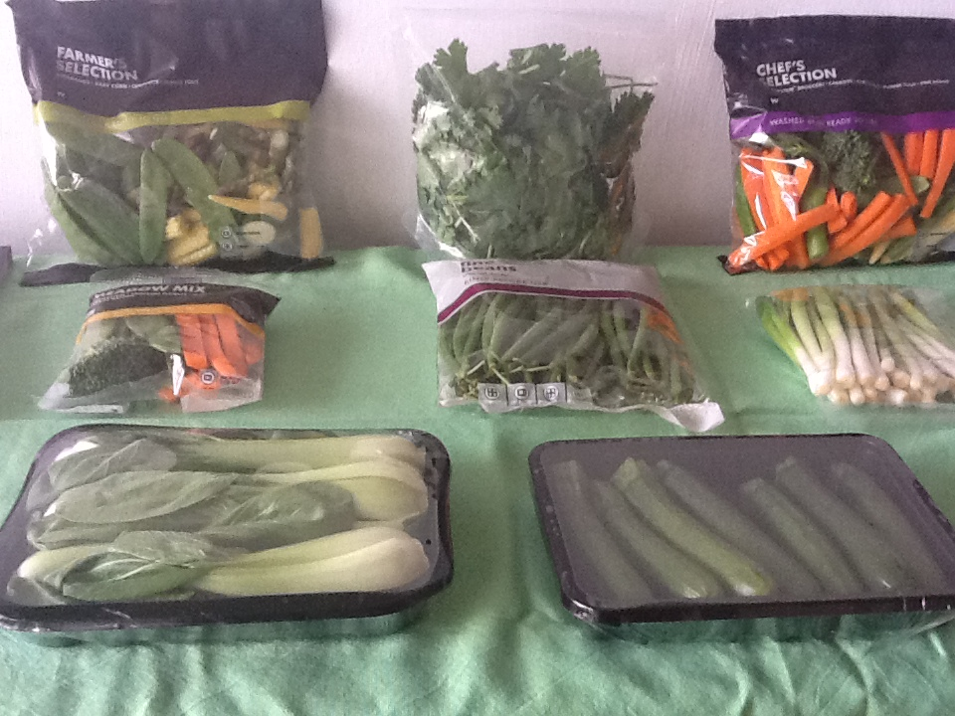
Success Story – public/private partnership for harmonizing
phytosanitary import requirements
Key activities
PRA
Industry mitigation
through GAPs
and
Food Safety
Measures
Dairy, fisheries
Identified for action

Slide 11
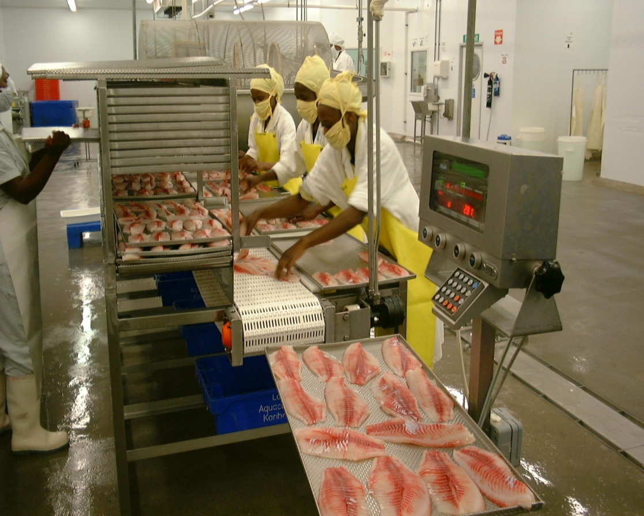
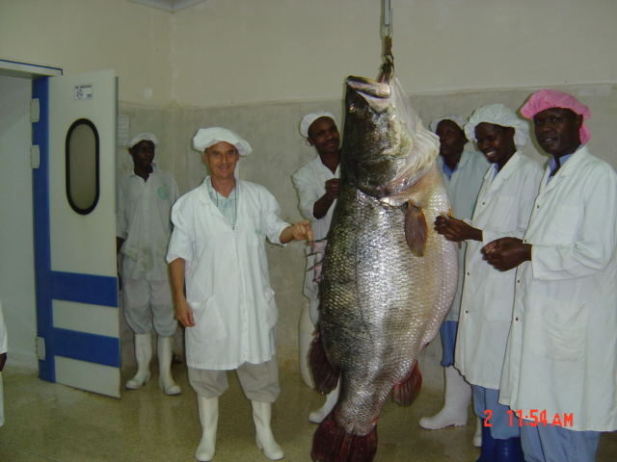
Factories that are
HACCP Compliant

Slide 12
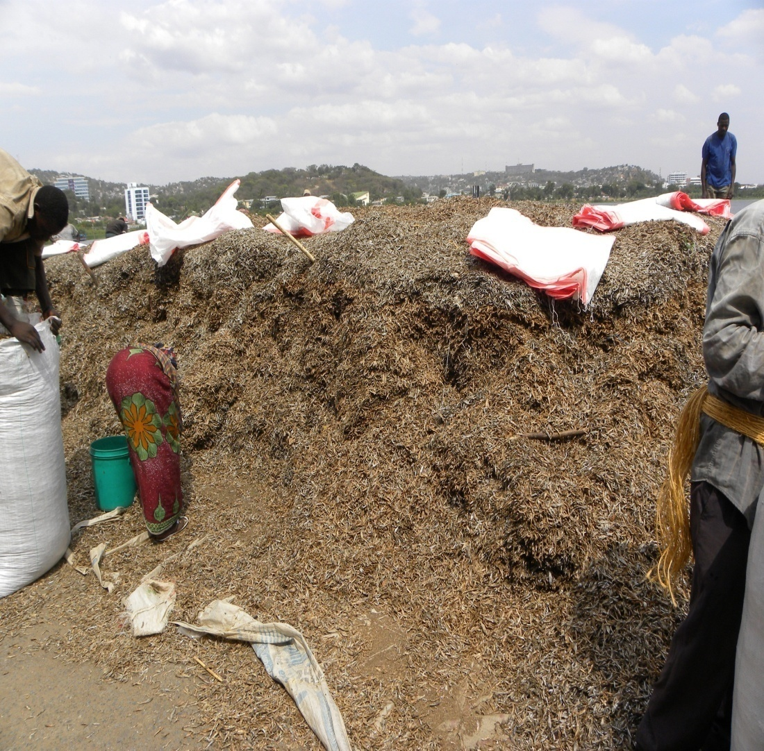
Success story: the pelagic fish industry
(Dagaa/Kenya, Kapenta/Zambia, Mukene/Uganda)
10 Years ago
Poor harvesting methods
Inadequate food safety standards
Poor handling practices

Slide 13
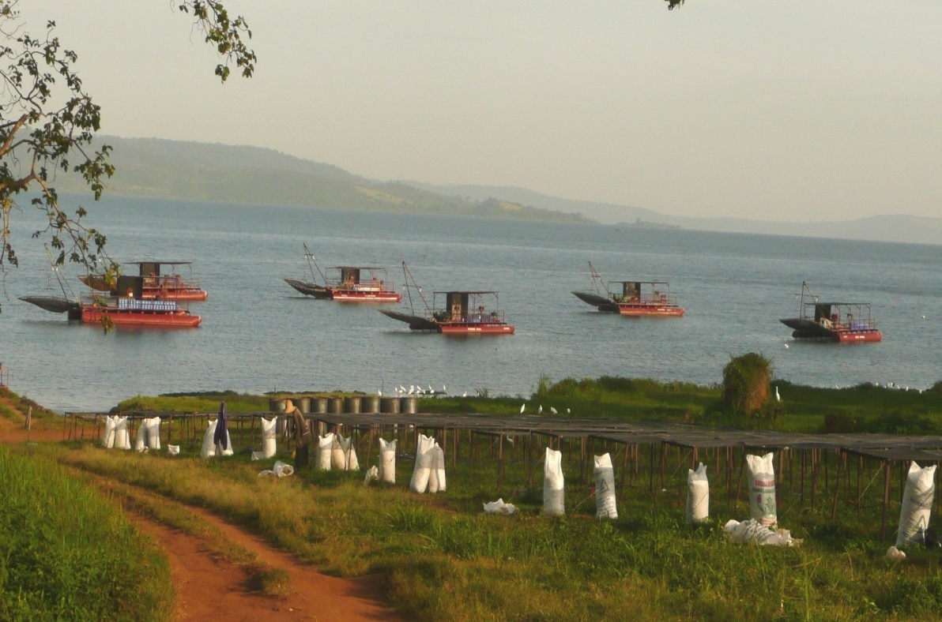
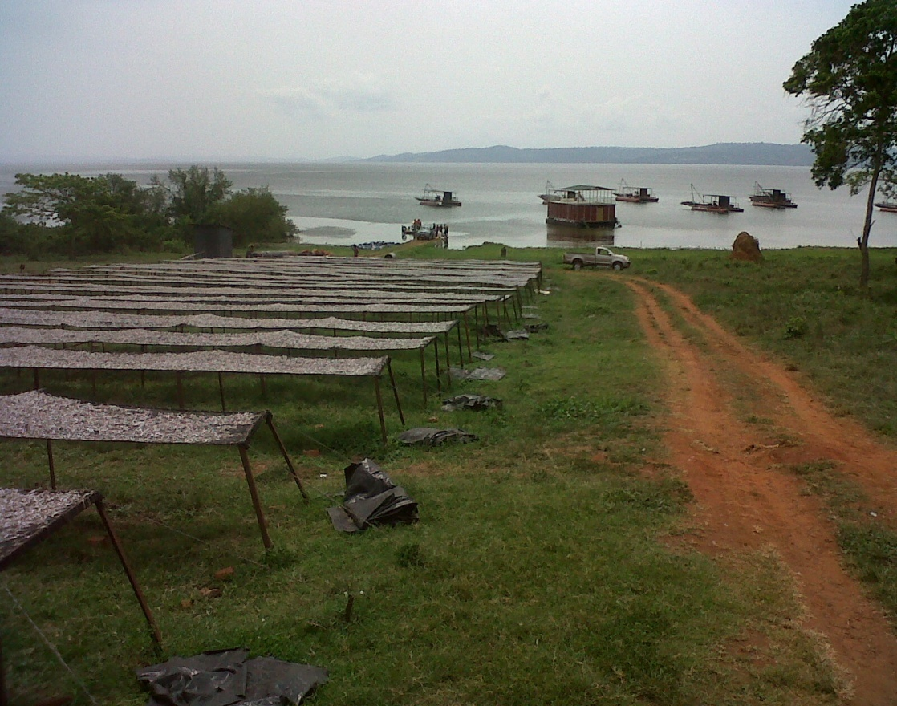
Today :
Modern harvesting
technology
Improved handling
and drying
Improved food safety
standards

Slide 14
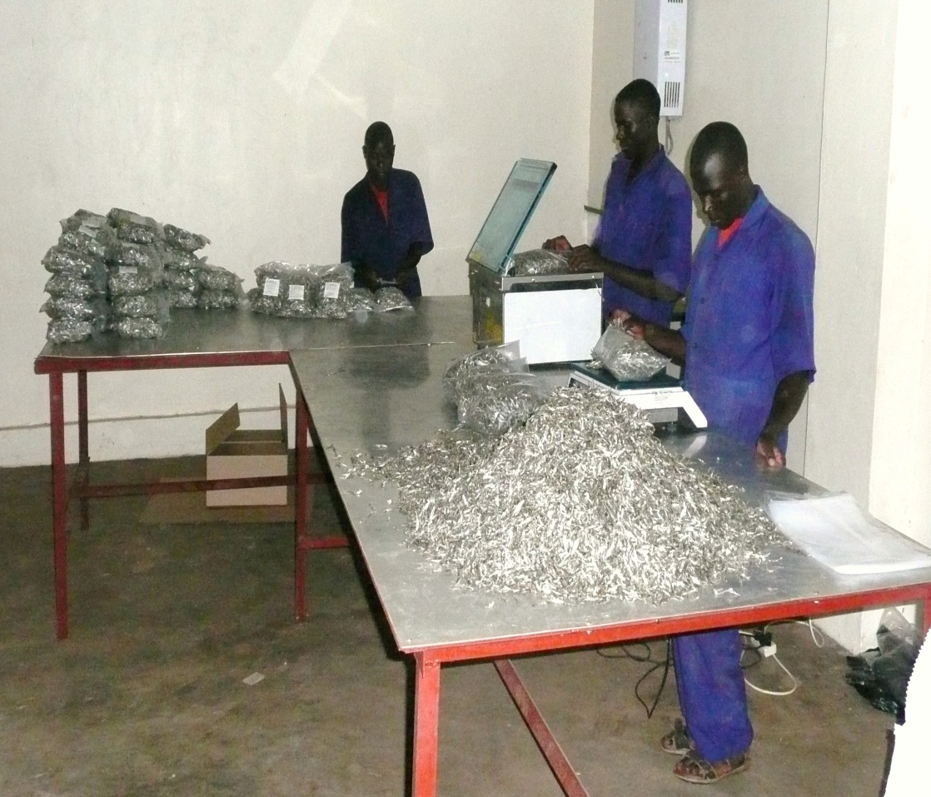
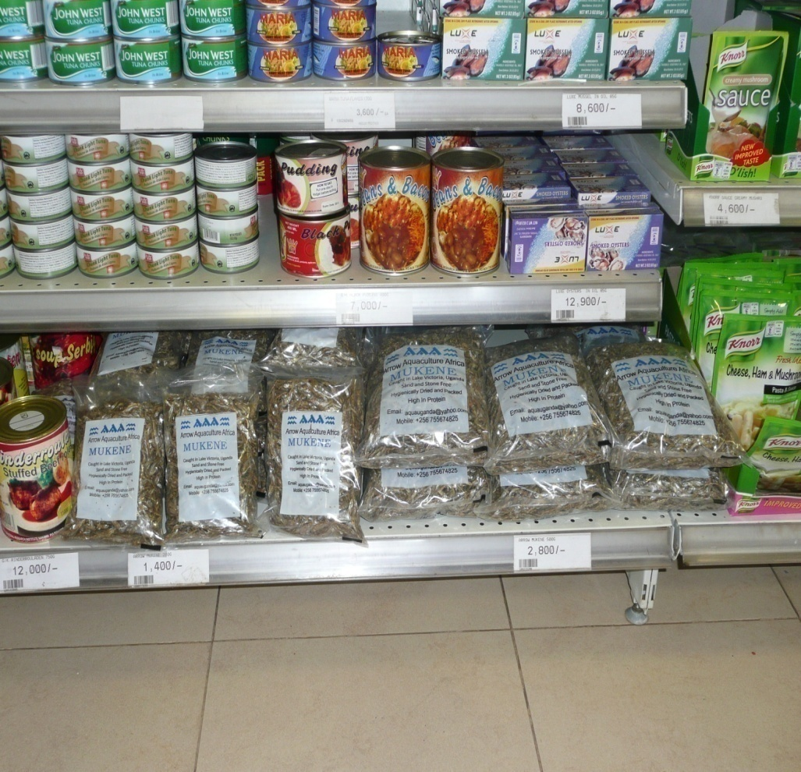
Success story : Domestic and Regional Markets expanding thru food safety/quality management and
Value addition

Slide 15
Conclusions
Effective coordination mechanism at tripartite level (EAC-COMESA-SADC)
Legally binding decisions
Tripartite structure to enable harmonization, equivalence and mutual recognition
Tripartite structure to enable effective capacity building including regulatory reforms
Partners on board include DFID, AFDB, STDF and partners
Challenge is aligning partners with regional/tripartite integration priorities
How does PACA or GFSI support the tripartite agenda ?
Are there lessons for ECOWAS and other RECs ?

