Slide 1
Integrated ecosystem management in Burkina Faso
Rio de janeiro, june 2012
Dominique ZONGO
National Coordinator of SILEM project/PNGT2,
Zongo_dominique@yahoo.fr
Adapted and presented by
Mr Mamadou HONADIA
PS/NCESD, mhonadia@gmail.com
BURKINA FASO

Slide 2
OUTLINE
Background, rationale and objectives
Approach and geographical coverage
Results
Effects / Impacts
Lessons learned

Slide 3
1. Background, rationale and objectives
Burkina Faso: Sahelian country (steppes and savannahs) with low income;
Over 70% of rural population rely on the exploitation of natural resources (agriculture, livestock, forestry);
Low level of basic equipments in socio-economic infrastructure ;
Land degradation and vegetation cover, accentuated by climate change;
High pressure on wetlands, especially on low land;
Programs like the PNGT2, based on community demand is welcomed; However, demand is more investments in community-oriented socio-economic infrastructure;
====➔Preparation of SILEM from 2001 to 2004.

Slide 4
1. Background, rationale and objectives
The SILEM’s program goal :
Synergistically with CBRD2, a project intitled “Improved in a sustainable manner the productivity of natural resources in watershed ecosystems” in providing funds "reserved" for the GEF was adopted:
(i) provide better incentives to rural communities to demand and implement micro judicious management and conservation of the ecosystem;
(ii) Build capacity of relevant institutions and decentralized management of micro watersheds.

Slide 5
1. Background, rationale and objectives
15-year program divided into three five-year phases:
Pilot phase;
Extension phase;
Consolidation phase
For the pilot phase, the intervention was focused around:
Capacity building of local communities (RCL);
Institutional capacity building;
Local Investment Fund (IDF);
funding:
U.S. $ 4.5M GEF
U.S. $ 20.5m WB (IDA => PNGT2 financing);
U.S. $ 0.4m from the Government of Burkina Faso

Slide 6
2. Approach and geographical coverage
Ecosystem approach at the micro watershed level (such as spatial unit of analysis and planning) was
Based on:
Community empowerment;
Community demand;
Local project management;
Coherence and synergy of investments on shared resources;
Diagnosis and collaborative planning;
Individual and collective actions consistent with the objectives.

Slide 7
Preparation;
Coming in force
ESTABLISHMENT: Committee control; CCST; Collaboration protocols
Choice of MBV
information;
Frameworks for
Development of PGIE
Implementation of organizational arrangement
Operationalization field
MONITORING participatory performance effects / impacts; supervision
Monitoring - Evaluation
Investment Phase
Development of PAI
convention
funding
training
execution
technical support
Reporting / capitalization
administrative closure
Strengthening Capacity in maintenance investments
securing property facilities
Closing the Project

Slide 8
3. Results
13 218 people directly benefited on capacity building and 67 sessions of inter village were held (22% of funding);
2971 micro-projects implemented (56% of funding)

Slide 9
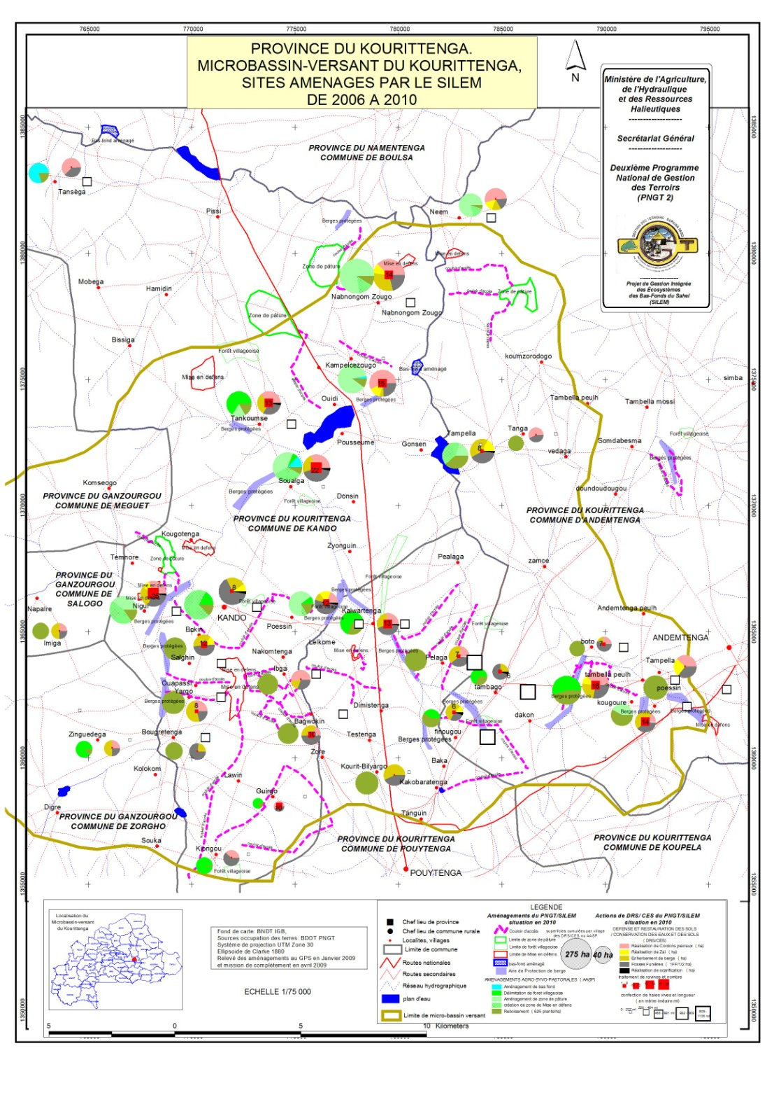
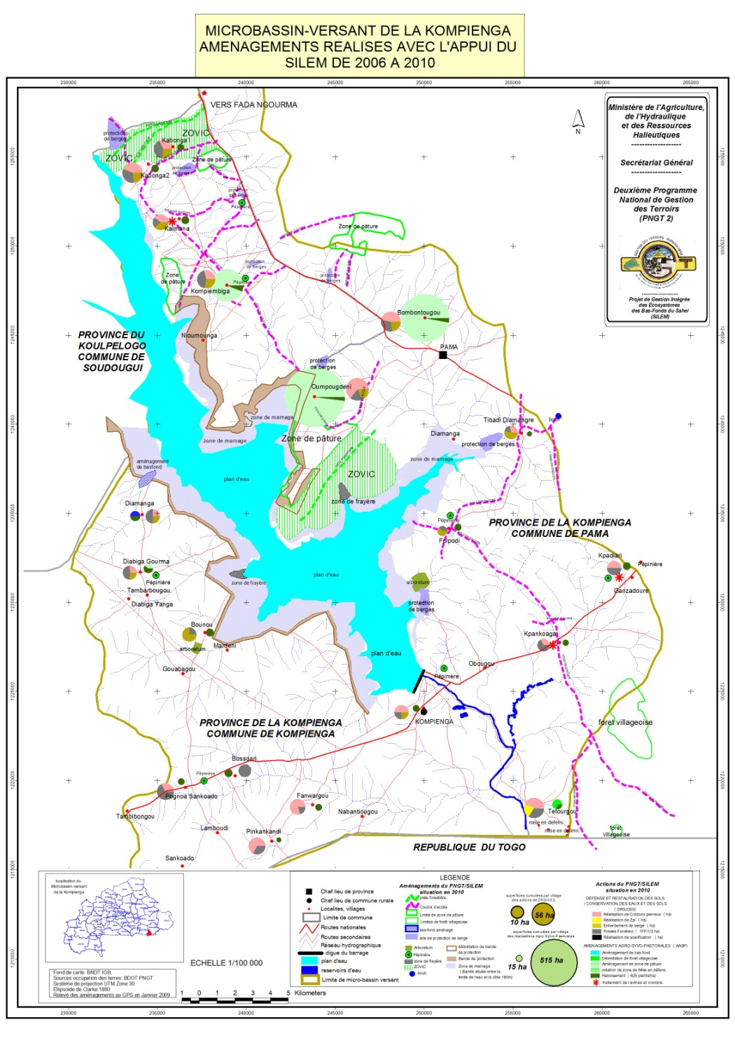

Slide 10
3.1 Activities executed
Protection and restoration of soil / water conservation and soil fertility * 3837 ha of land treated with stone bunds; * 8,307 manure pits; * 26 500 m of vegetated bunds; * 245 km of shoreline marked, protected and reforested; * 1004 ha of degraded land recovered (scarification); * 1941 ha zai; * 193 ha of half-moons;

Slide 11
3.1 Activities executed
Reforestation and Forest Management:
* 195,720 seedlings produced in 17 nurseries ; * 941,936 seedlings planted at the rate of 40% of survival ; * 56, 440 m of hedgerows made ​​up; * Opening of 117 km of firewall or transects and 17 km of forest tracks; * 363 ha of forest exclosure; * 142 ha of forest enriched by direct seeding (commercial species); * A botanical conservatory of 11 ha; * 25 farms agro-pastoral activities created.

Slide 12
3.1 Activities implemented
Structural support for agricultural production:
* 82 hectares of lowland managed, mainly for rice production; * 84 ha of lowland rehabilitated; * 8,800 kg of improved cereal seeds provided;

Slide 13
3.1 Activities implemented
Structuring support to livestock production: * 41 555 ha of grazing areas established and equipped with 12 pastoral water basins; * 417 km of access corridors well managed; * 235 kg of forage seeds supplied.

Slide 14
3.1 Activities implemented
Structuring to support fish production:
* Two spawning sites created and managed for fish spawning; * 4 lakes have received figerlings in 2 provinces (Sanmatenga and Kouritenga); * 61 teams fishermen equiped with legal material.

Slide 15
3.1 Activities implemented
Research/Action (as pilote):
* The provision of 260 kits (bee hives + equipment); * Mowing and conservation of 22,000 bales of natural forage for livestock; * The acquisition of 19 125 kg rock phosphate and 3 355 kg Compost Plus; * The provision of 73 geniters aulocodus (commonly called or agouti);

Slide 16
3.2. Capacity building
Trainings of 13 218 people, among which:
6029 auditors trained and recycled on diverse themes (participatory follow-up, financial management, investments’ maintenance, etc.).
1 445 auditors informed and sensitized on the various legal texts (Codes forester, environment, water, pastoral) 460 producers trained in apiarian technique and equipped in hives and kits of exploitation;
1 186 auditors in technic of zaï;
1 162 auditors in technic of forage crop production;
1 auditors in protection of banks;
2 761 auditors in production and use of the organic manure technic ;
1 377 producers trained in techniques of preparation of rocky Cords;

Slide 17
Main results
In sum:
83 % of the 2971 micro projects executed are evaluated very good quality and 15 % of average quality;
Land tenure safety (legal texts) has been obtained for the overall managed sites with mayors);
In the concerned municipalities, the investments in GRN passed from 7 % to 22 % of their resources.

Slide 18
4. Benefits and impacts of the project
The biophysics environment :
Strengthening of the floral potential (10 new reappeared species);
Recolonisation of certain rustic forests by faunae ( 8 species registered);
Restoration of degraded lands previously unfit to economic activities.

Slide 19
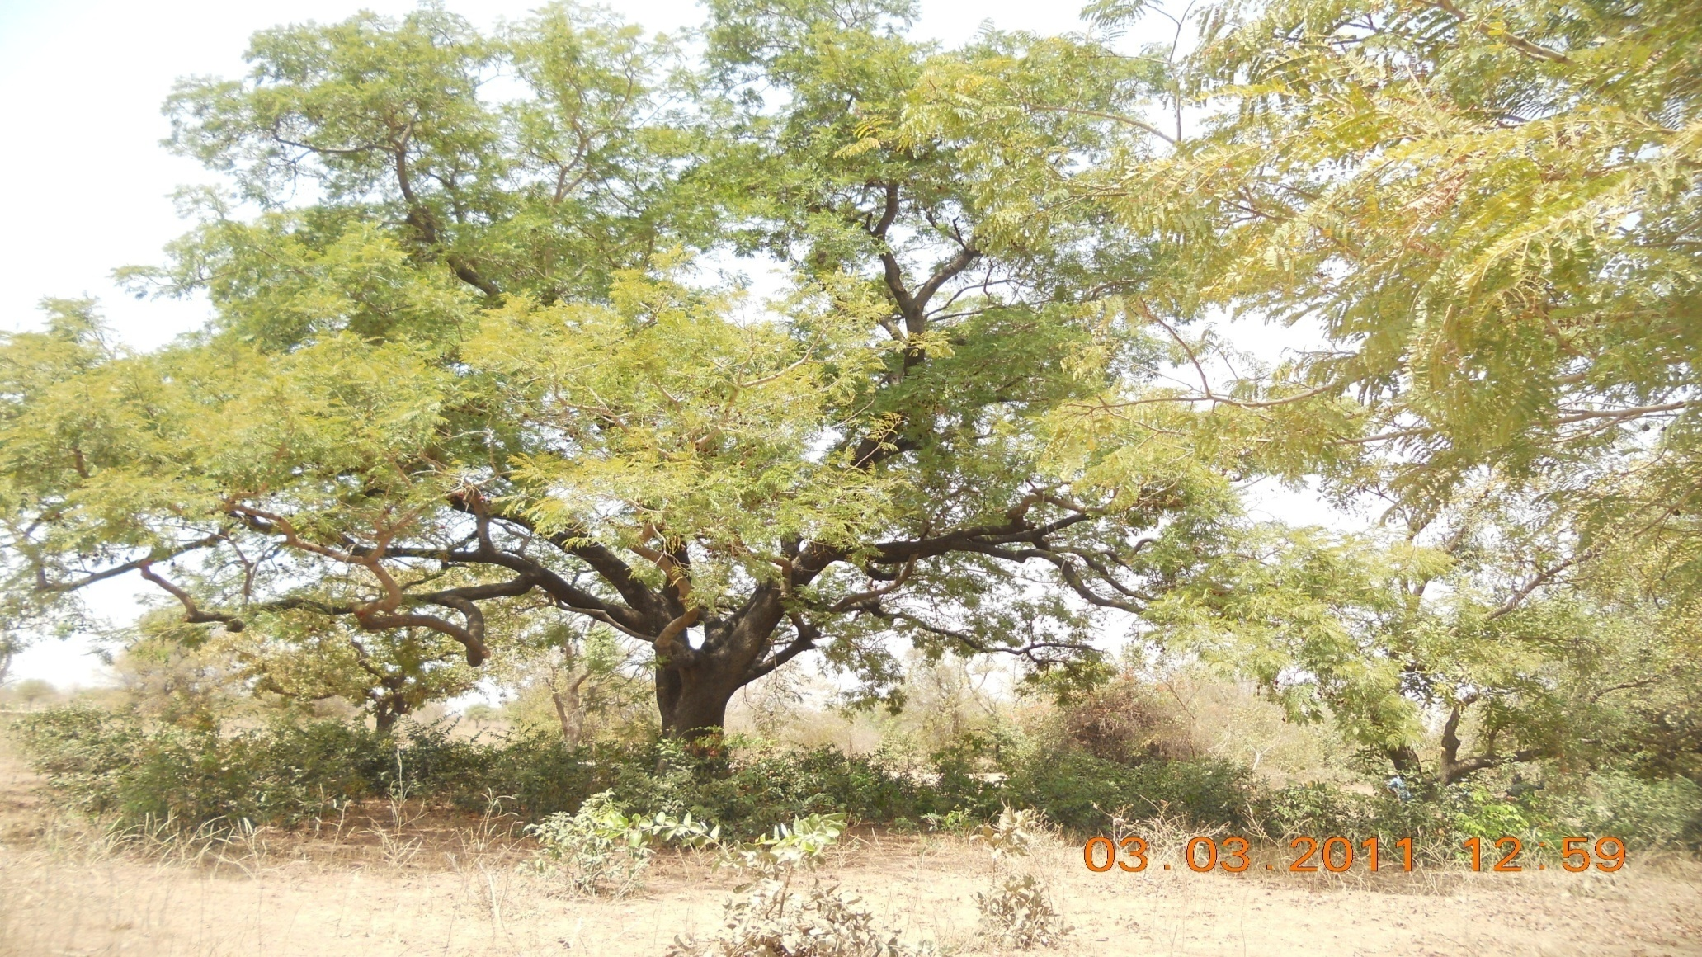

Slide 20
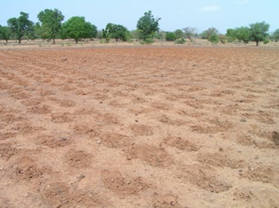
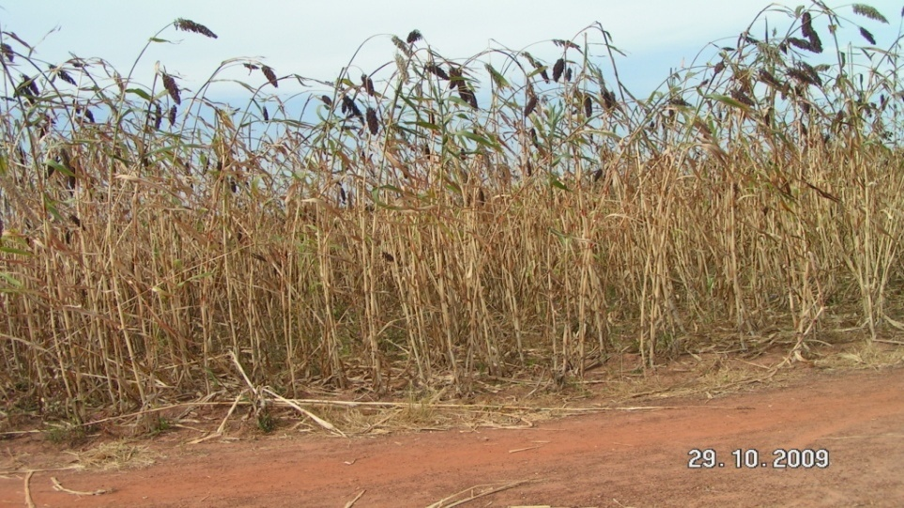
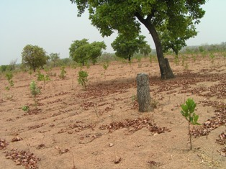

Slide 21
4. Benefits and impacts of the projects
The income of the beneficiaries:
Increase of yield of 23 % for cereal crops due to the use of techniques associated with intensification.
The social peace :
Significant reduction of conflicts between farmers and breeders (ex of Kouritenga: 22 official conflicts in 2006 in zero case in 2009);
Better and greater links between villages due to various joint meetings and shared resources management ;

Slide 22
5. Lessons learned
Synergy between GRN project and operations taking into account the socioeconomic investments guarantees success, but there is a need to open a window of financing under the GRN;
Empowerment of the actors at the community level, with local project ownership guarantees the ownership and duplication of actions;
Integrated management approach at the micro watershed scale contribute to improve the social peace taken into consideration the interests of all the actors;
The land tenure safety of community productions is essential for sustainability;
Programmatic approach of the operations ( 10 - 15 years) to consolidate experiences and perceive impacts is fundamental

Slide 23
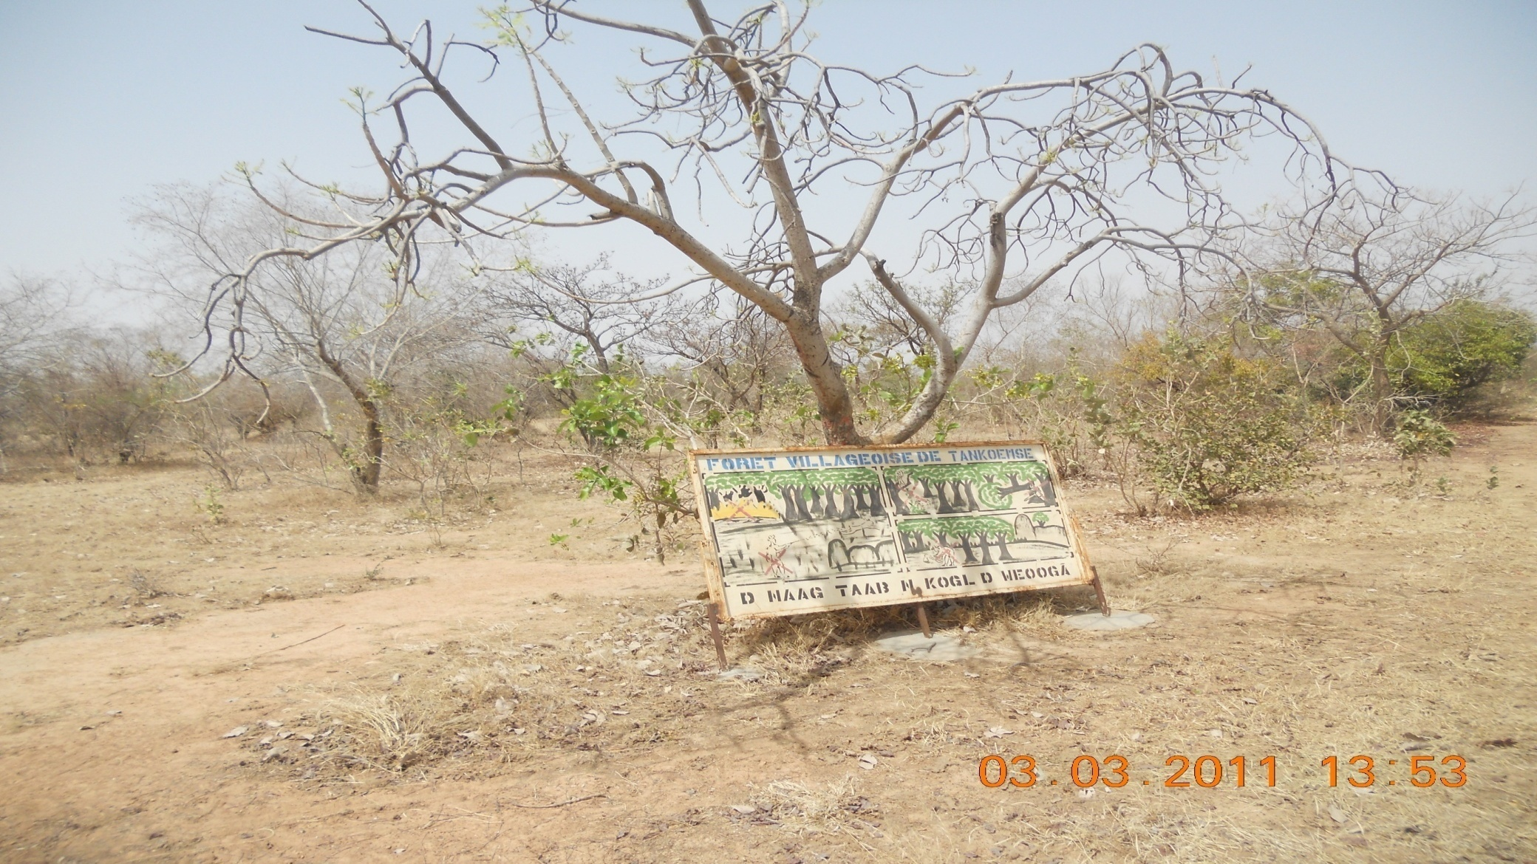
THANK YOU FOR YOUR ATTENTION!!!

