Slide 1
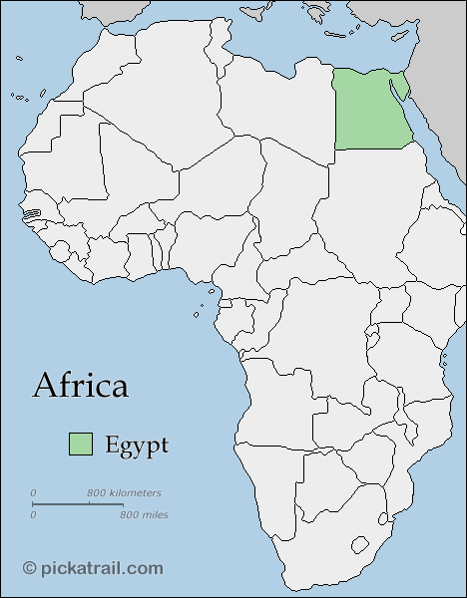
AMCOST
Prof. Dr. Nadia I. Zakhary
Minster of Scientific Research
Egypt
16-17 October, 2012

Slide 2
The African region had historical achievements in science and technology, though for a long period, the region neglected this important field.
The great diversity in such capacities among countries in the region in itself should stimulate the opportunities for co-operation.
Scientific and technological partnerships both within the region and at a global level need to be stimulated for regional sustainable development.

Slide 3
The rationale for wider application of science and technology lies in targeting provision of basic needs
Africa is a region with a majority of population below the poverty threshold. Poverty is indeed one of the great sources of environmental degradation.
Basic needs will be met through institutional changes that ensure the ownership of knowledge by the poor.
Along with such institutional change, science and technology should focus on improving the agriculture and food sector, developing appropriate technologies for industry, ensuring energy supplies, health care and providing environmental management.

Slide 4
In agriculture, research should be focused on holistic systems of farming, and improving small holder cropping patterns.
In industry, more research provision is required for development of relevant technologies, innovative and cost-effective improvement of existing technologies.
More efficient commercial energy systems should be paralleled by application of science and technology to the development of renewable energy systems, based on solar, biomass and wind technologies.
In health care, science and technology should be applied to diagnose diseases and upgrade traditional and herbal medicine.
In the field of environment, priority should be attached to conserving the valuable tropical ecology of the region and associated biodiversity, in an ecologically sustainable management of agriculture and fishing, as well as controlling and reversing industrial pollution.
Water resources for drinking and irrigation; as well as water management needs amelioration.
New technologies like electronic technology, biotechnology and nano-technology need to be developed.
Information technology, could be utilized in the region for communication and exchange of experience.

Slide 5
The quality of human capital will gain from greater attention to scientific and technological education, formally and informally
Disciplines related to science and technology should have a higher profile in primary and secondary education.
The quality of teaching requires improvement and facilities such as teachers, laboratories and equipments.
Technical schools and polytechnics should be given a more central role in the educational system leading to small and medium sized enterprises.
Scientific and technological research and teaching capacities of universities must be built up, and the cream of scientists and technologists should engage in teaching and research.
Appropriate research facilities and arrangements for scientific exchange should be further improved.
Scientists and technologists must have a crucial role in decision-making in government and in enterprises.

Slide 6
Greater interaction between business and industry with higher education, science and technology
Science and technology should be applied for achieving sustainable development of business and industry .
Linkages between business and industry on the one hand, and research institutions on the other, need to be expanded, focusing on practical product development. Accordingly, industrial resources allocated to research and development will be increased.
Heavy reliance on government-funded research should be reduced.
Capacities for selecting, absorbing and integrating the major technological transfers through direct investment should be improved, enabling building up of endogenous scientific and technological strength.

Slide 7
Government policy is crucial to effective utilization of science and technology
Parliamentarians agreed that governments in the region have the responsibility to develop strategies for science and technology, within the framework of overall sustainable development policies and machinery for implementation and evaluation.
Governments should determine priorities, secure adequate funding, negotiate in multilateral forums, establishing bilateral co-operative arrangements, create an enabling environment for the private sector and the community to establish its own scientific and technological research facilities.

Slide 8
Focusing on Basic Needs is a must
- In any practical strategy for sustainable development in the region, very high priority must necessarily be attached to assuring the basic needs of the population.
- People living below the level of minimum needs cannot have access to benefits of science and technology, as they have neither the education nor the economic capacities.
- The provision of such basic needs should be anchored on the creation of employment opportunities and the ownership of assets and knowledge.
- To achieve such an objective, economic and social institutional changes are required in the region.

Slide 9
It was a great honor for Egypt to be the chair of the AMCOST IV since May, 2010 and until now and to host its meeting on the 28th to 31st of May 2010.
It was also a great opportunity to host the meeting of the parliamentarians of African countries of the AU during the last month.
And now, it my great pleasure to move this honorable chair of the AMCOST to our sister country: the Congo Brazzaville.

Slide 10
Thank you
Notes:
10

