Slide 1
Science Technology and Innovation Programmes in the AU/NEPAD Agency
Chimwemwe Chamdimba
NEPAD Science Technology and Innovation Hub
AU/NEPAD Agency

Slide 2
Presentation Layout
STI within the NEPAD Agency
What are we doing in STI
  Programmes
Outcomes so far?
  what if we were not there?
Lessons learnt
Looking ahead

Slide 3
AU/NEPAD Agency
To conduct and coordinate research and knowledge management,
To monitor and evaluate the implementation of programmes
To advocate on the AU and NEPAD vision, mission and core values
To mobilise resources and partners in support of programmes.

Slide 4
NEPAD Science Technology & Innovation Hub (NSTIH)
Established in the office of the CEO
Main coordinating center for all STI programmes within NEPAD Agency
Recommendation from the 1st Bureau meeting of AMCOST IV

Slide 5
Main Functions of NSTIH
Enhancing, coordinating and consolidating NEPAD STI programmes and projects
Facilitating effective delivery of STI programmes across Africa based on the NEPAD Agency mandate
Mainstreaming STI into NEPAD programmes and projects
Enhance the visibility of Impact oriented NEPAD Agency STI programmes

Slide 6
Current Programmes of NSTIH
Implementation of the CPA

Slide 7
Programme Focus
R&D programmes
Human capacity building
Institutional strengthening
Support to RECs

Slide 8
African Biosciences Initiative
Establishment of regional networks of laboratories with state-of-the-art facilities
Four networks have been established:
  Biosciences Eastern and Central Africa (BecA)
  Southern Africa Network for Biosciences (SANBio)
  (http://www.sanbio.org)
  West Africa Biosciences Network (WABNet)
  North Africa Biosciences Network (NABNet)
Each network has a hub and nodes implementing regional flagship research programmes and capacity building activities in different disciplines

Slide 9
Achievements in Capacity Building
MSc and PhD support
  BecANet 25 MSc 13 PhD
  NABNet 12 MSc 24 PhD
  WABNet 6 MSc
  SANBio 12 MSc 7 PhD
  Total 55 MSc 44 PhD

Slide 10
Key Outcomes
A traditional remedy for HIV/AIDs validated (SF2000).
Using our natural resources, indigenous knowledge and scientific innovation
Currently ready for Phase I Clinical Trials.

Slide 11
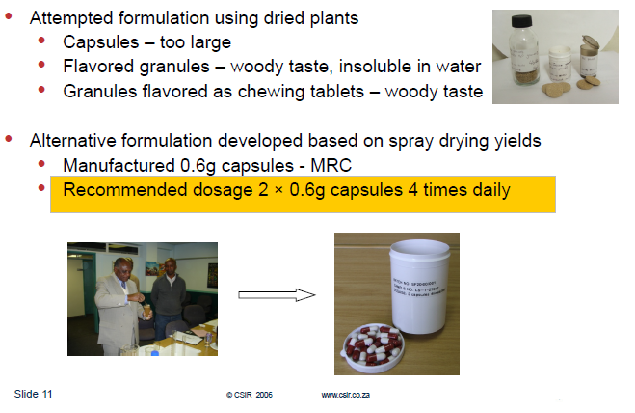

Slide 12
Key Outcomes
Establishment of State-of-the-Art research facilities at the BecA Hub-ILRI, Nairobi which has enabled:
  Formulation of a challenge fund to build regional capacity for biosciences research - The Africa Biosciences Challenge Fund (ABCF)
  Tackling important agricultural constraints in food production, nutrition and animal health http://hub.africabiosciences.org/about-abcf/

Slide 13
Key outcomes
Establishment of a Bioinformatics Core Facility at the University of Mauritius
Researchers from 10 institutions within SADC trained in using a stand alone Bioinformatics toolkit (which can run without the internet)
SADC PGR Policy Guidelines have been developed and Member States supported to review national PGR and PGR-related policies

Slide 14
Key outcomes
Over 600 farmers trained on improved mushroom production technologies
Establishment of Pilot Mushroom Technology Park in Namibia and Genebank in Swaziland
Action –research – 65 fish farmers (reaching approx 400 members plus others) ; 2 districts of Malawi www.nepadsanbiofishnode.org

Slide 15
3 Year-Fish Farming Intervention Doubled Fish Production

Slide 16
Indigenous Knowledge Systems Interventions
The BIKS qualification and programme was adopted by the SADC Ministers of S&T at their meeting in Seychelles (August 2009) as a regional IKS teaching programme.
Establishment of African Young Scientists Initiative on Climate Change (AYSICC) – Continental youth network on IKS and climate change

Slide 17

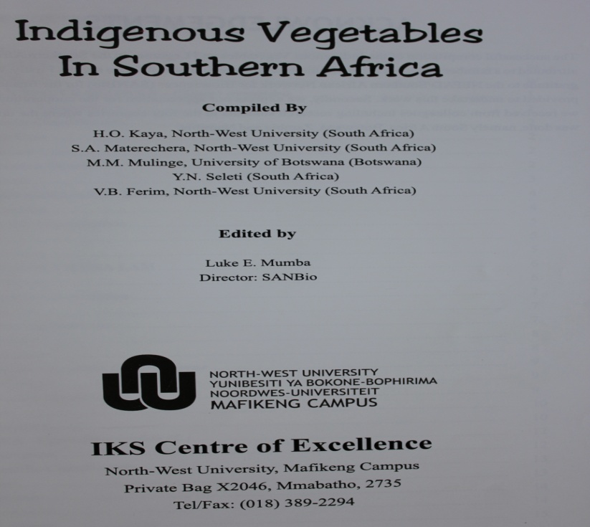
IKS Publications

Slide 18
African Biosafety Network of Expertise (ABNE)
Provides biosafety information resources to member states
http://www.nepadbiosafety.net
Conducted training sessions on biotechnology regulatory processes in Burkina Faso
Trained evaluators in Ghana
Trained inspectors for field trials in Nigeria
Programmes on awareness creation & understanding for government officials

Slide 19
Science & Technology for Health
Currently involved in the following programmes:
  Eval Health: Development of Impact Assessment
  Tools for R & D projects/programmes in Africa
  African Medicines Regulation Harmonization (AMRH) in RECs

Slide 20
Almost 85% of Sub-Saharan Africa with MRH projects at various levels
REC progress
REC
Status
Comments
EAC
West Africa WAHO/UEMOA
ECCAS/OCEAC
SADC
North/Northeast
Africa
MRH Project Proposal finalized 2011
MRH implementation framework agreed by end 2012
Under consultation
Partners consultation
Under consultation
Project launched 30th March 2012
WAHO/UEMOA
EAC
OCEAC
Completed or in-process RECs | Countries covered | Total members* | % pop covered
EAC & ECCAS/OCEAC EAC, ECCAS/OCEAC, ECOWAS EAC, ECCAS/OCEAC, ECOWAS, SADC | 12 (20%) 26 (46%) 41 (74%) | 11 26 41 | 17% 45% 72%
SADC
We are pushing forward those RECs that are ready while continuing to work with the remaining regions
Source: BCG analysis
20

Slide 21
NEPAD SOUTHERN AFRICAN NETWORK OF WATER CENTRES OF EXCELLENCE
Aim - To improved human and environmental well-being through research and development in water and sanitation
Hub established at the Stellenbosch University in South Africa
Financial support from Government of South Africa -DST and EC support
Nodes currently existing in Mozambique, Malawi, Zambia and Botswana
West Africa Water Sciences Network established in October 2009

Slide 22
Laser Technology
Implemented through the African Laser Centre (ALC) hosted by the CSIR – South Africa
A pan African network focusing on research and training with membership from all the regions of the continent
Implemented 47 projects from 2006 to 2009
Trained 83 MSc and 119 PhD from 2006 to 2011

Slide 23
African Mathematical Sciences Network (AMINet)
African Institute of Mathematical Sciences (AIMS) in Cape Town was designated a centre of excellence at AMCOST 1 in 2003
Since 2003, AIMS has graduated 412 post-graduates from 32 different African countries
AIMS coordinates the implementation of AMINet where other nodes have been established in Senegal, Ghana and Nigeria

Slide 24
Material Science
Quality Infrastructure
  Focus on standards harmonisation

Slide 25
Support to the RECs
AMRH – Harmonisation of regulation of medicines
SADC – SADC PGR Policy Guidelines; Process of setting up the SADC desk
COMESA – Development of COMESA Programme on STI
ECOWAS – Development of ECOPOST

Slide 26
Policy Programmes
ASTII Programme
Overall Goal : To contribute towards the improvement of the quality of science, technology and innovation policies at national, regional and continental levels
Purpose: To strengthen Africa’s capacity to develop and use Science, Technology and Innovation (ASTII) Indicators.
Publication of the Africa Innovation outlook a major milestone for informing policy and programme development.

Slide 27
Funding of Programmes
In-kind support – Member states hosting hubs and nodes
Support in cash – Some member states and partners have contributes financially to NEPAD programmes

Slide 28
Challenges
Mobilisation of adequate and sustainable resources
Private sector involvement
Demonstrating accountability with no benchmarking/baseline
Wide differences in project implementation capacities amongst Member States

Slide 29
Challenges
Maintaining network approach
Institutionalisation of programmes in RECs and Member States
Linking the CPA programmes to other sectoral programmes

Slide 30
Lessons Learnt
The importance of Monitoring, Evaluation and Impact Assessment
The focus should be on impact and bringing products to the market
  Technology delivery to the ground
  Engagement of Private sector

Slide 31
Lessons Learned
Importance of a robust Knowledge feedback system to enable reflection and learning for improving design of interventions
  Importance of communicating the benefits of STI programmes
  Funding of STI programmes by member states is important for sustainability

Slide 32
Lessons Learned
Sustainability
  Member states need to have policies, strategic plans and priority projects/programme clearly set and communicated
  Strengthening institutions to carry on with programme beyond partner support

Slide 33
Opportunities
The networks and centres of excellence that have been established
Emerging partnerships on STI in Africa and world wide
Advances in STI and engineering worldwide
Africa’s Economic growth and development
Public pressure for solutions
Existence of RECs

Slide 34
Looking Ahead
Review of the CPA
Based on the lessons learnt since 2005, focus on out-scaling and up-scaling current programmes across Africa

Slide 35
Thank you

