Slide 1


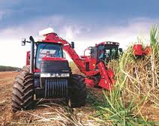
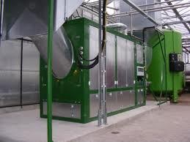
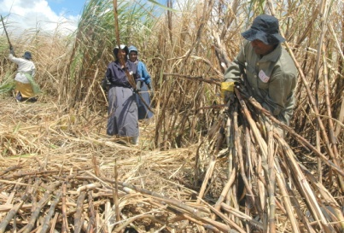
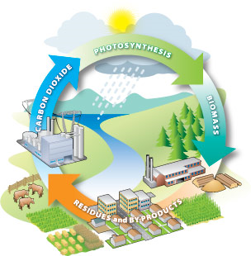
Mainstreaming African Bioenergy Framework and Policy Guidelines
Monga Mehlwana
Industrialisation & Infrastructure
Regional Integration & Trade Division
UNECA
mmehlwana@uneca.org

Slide 2
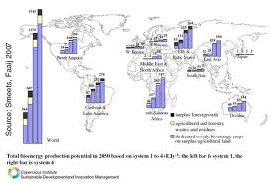
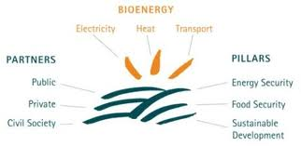

Presentation Outline
Why Africa Bioenergy Policy Framework and Guidelines?
Understanding Bioenergy in African Context
Key Bioenergy Issues & Policy Considerations
Process of Sustainable Bioenergy Policy Development
Bioenergy Policy Implementation Action Areas
M & E Implementation
Implementing the Bioenergy Framework & Policy Guidelines
Conclusion and Recommendations

Slide 3
Schematic illustration of Africa Bioenergy Policy Framework & Guidelines

Slide 4
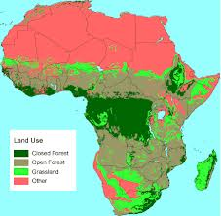
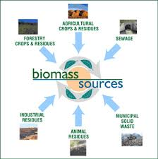
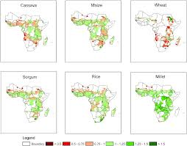
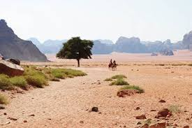
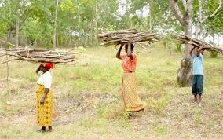
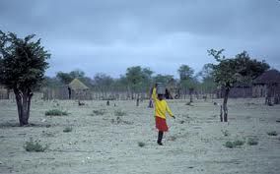
Why Africa Bioenergy Policy Framework and Guidelines?

Slide 5
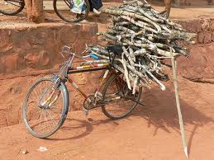
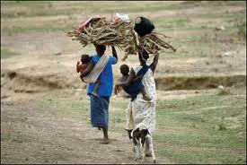
African needs bioenergy because …
Good bioenergy policies support the attainment of sustainable development goals & reverse is true
Major world developments in the field of modern bioenergy but in Africa yet to properly harness this source of energy
Regulatory frameworks developed to manage negative impacts of bioenergy in the world, but not sufficiently done in Africa
RECs have targets for RE, incl. bioenergy, but these unlikely met
Growing energy deficits impact negatively on economic growth.
African population depends on traditional biomass as a primary source of energy
Negative impacts of such use are known

Slide 6
The purpose of the Framework
Why does Africa need a harmonized bioenergy approach?
What are the opportunities & associated risks?
Which particular policy issues will be addressed?
How should the Framework be designed?
What are accompanying implementation strategies &plans?
How will strategies and plans provide desired goals?
How will this Framework & plans & strategies be implemented?
“… (a) Build consensus on shared framework that inspires & provides guidance to individual coun­tries and regions in developing bioenergy policies and regulations; and (b) Enhance awareness among African policymakers and the civil society about the need for environmen­tally friendly and socially acceptable bioenergy development policies….”

Slide 7
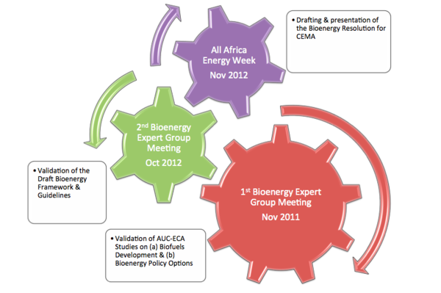
The process of developing the Framework

Slide 8
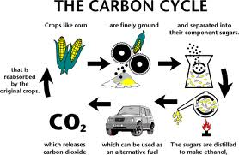
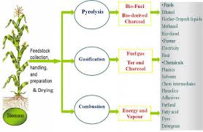
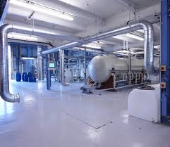
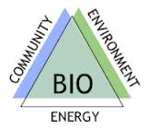
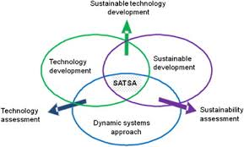
Understanding Bioenergy in African Context

Slide 9
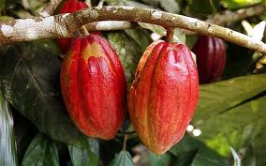

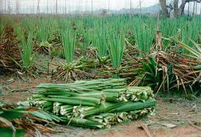
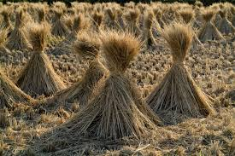
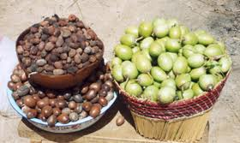
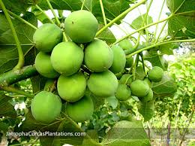
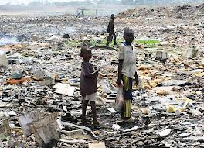
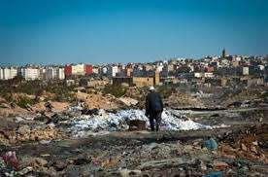
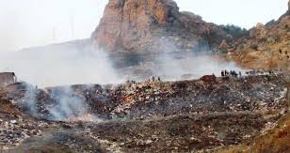
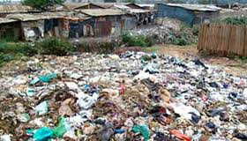
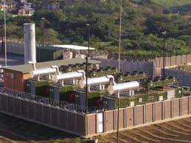
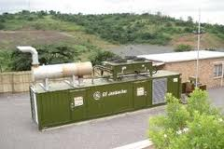
Abundance of resources
Most opportunities for bioenergy development are in beneficiation of various feedstock types
Cocoa plant
Palm Oil
Sisal
Rice Straws
Shea butter
Jatropha
Africa can generate a great deal of energy from municipal waste
INCL:
World’s largest uncultivated land, available labor

Slide 10




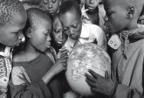




The benefits of bioenergy development
Economic benefits
Rural development & transformation
Can enhance food security
Improve farmers’ revenue (esp. residues)
Local income in valorization of residues
In macro-terms, reduction of imported fuels & local GDP growth
Social benefits
Energy equity and access
Women empowerment
Improved livelihoods and addressing health concerns
Environmental benefits
Use of EE biomass stoves reduces indoor air pollution and BC
GHG emission reduction in the transport sector

Slide 11
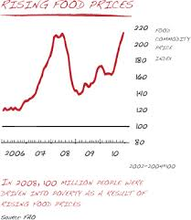
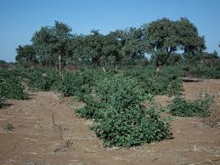
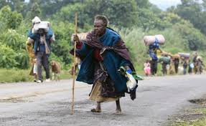
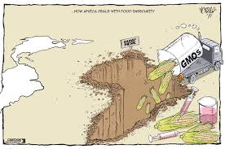
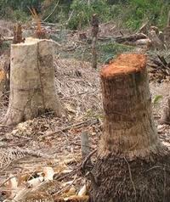
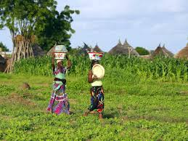
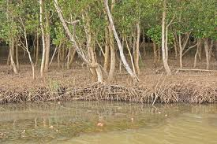
Known negative impacts
Increased food prices
Soil fertility loss
Community displacement
Food insecurity
Biodiversity loss
Land use changes
Threat to forests & wet lands

Slide 12

Challenges to development of bioenergy in Africa
Land requirement
Policy & institutional weaknesses:
Access to & efficiency of technologies
Increasing water shortage & insecurity
Lack of continental bioenergy experience for lessons
Making bioenergy costs competitive with petroleum products
The lack of distribution infrastructure
Energy, water and agriculture nexus
Gender, energy and development
Energy as a conduit to more active private sector

Slide 13

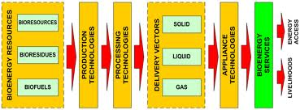
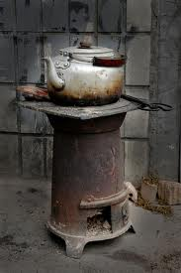



Key Bioenergy Issues and Policy Considerations

Slide 14
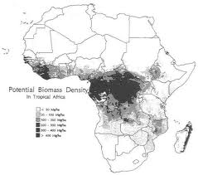
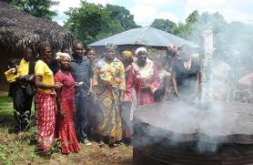
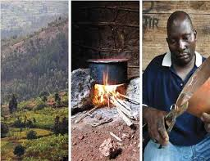
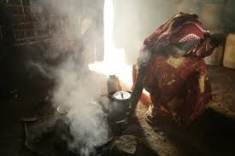
Overdependence on inefficient traditional biomass
Over 80% of traditional biomass used for cooking, heating & lighting
Leading to outdoor pollution
Mostly using inefficient technologies
Respiratory illness from indoor emissions

Slide 15
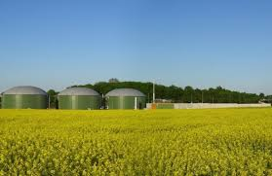
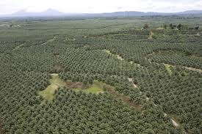
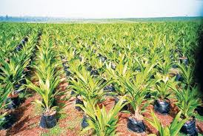
Imbalance between feedstock and scale of operations
Large amounts of feedstock and energy services are derived from processing biomass re­sources
Feedstock is available in large quantities but the scale of production is very low
Small- and medium-scale enterprises have greater potential to create positive micro and macro impacts on the economy
Balance has to be maintained between small- & large scale production as these are complementary & cater for different markets
Small scale production = for household consumption (heating and cooking)
Large scale production = high quality bioethanol for transport sector

Slide 16

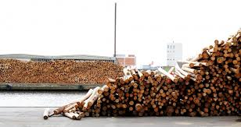


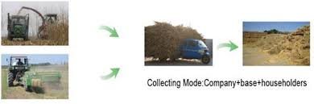
Non-integrated and linear policy processes
Water, energy, &food sectors are interconnected = conflicting policies and actions may affect each
Management of forest resources is often centralized = limiting locals' rights to access their natural resources & source of livelihood
Decentralization and devolution of power to local inhabitants is a proper instrument to promote access to energy through the multifunctional platforms and rural electrification schemes

Slide 17









Non-strategic natural resource management
± 80% of residential energy consumption in Africa comes from traditional biomass, often extracted unsustainably from forests

Slide 18

Lack of bioenergy markets and trade
Modern biomass is still an emerging market & small in Africa compared to the oil &gas:
Charcoal industry in SSA worth >$8b (2007) & >7m people dependent on sector for livelihoods
Economic value of charcoal industry in SSA may exceed US$12 billion by 2030, employing almost 12 million people (World Bank 2011)
Largely informal – revenue collected by govts far below that generated by this business

Slide 19






Limited R&D, standards and regulations
Cooking technologies in many African rural areas are substandard with low efficiencies, despite growing R&D elsewhere….
Improved end-use appliances/technologies available - can be rapidly disseminated with appropriated strategies i.e. promotion, manufacturing according to specified standards & training

Slide 20






High initial capital investment in bioenergy projects
The deployment of renewable energy technologies, i.e. biodigesters, LFG requires huge investment
Govts & international community to intervene to build markets for existing commercial & potential technologies
PPPs & incentivizing regulatory framework prerequisites to ensure market development

Slide 21




Mainstreaming gender in bioenergy development
Of the 1.2 billion people living on one dollar a day, 70 per cent are women
Lack of investment in low-cost energy supply systems compels women to continue using firewood for cooking and heating, with the associated health and safety problems
Collection and use of biomass is mostly the responsibility of women and girl children

Slide 22



Poor general bioenergy governance in Africa
No clarity of roles of all stakeholders
Lack of consistency and uniformity (conflicting laws)
Top down policies with little public participation
Near absence of PSP
Scarcity of information, etc.
“…institutions, policies, customs, relational networks, laws and regulations, property rights, stakeholders’ participation in policy development, access to knowledge, finance, information and education that fosters sustainable development of bioenergy…”

Slide 23





Process of Sustainable Bioenergy Policy Development

Slide 24



Developing vision for bioenergy development
Africa needs modern bioenergy to meet the increasing energy needs, to fuel its economy while protecting the environment and to improve the social wellbeing of its population, specifically in rural areas.
Translate the vision actions by governments and RECs, in partnership with civil society, the private sector and the international community.

Slide 25






Articulate clear objectives
Bioenergy development
Land, water & other resources opportunities & constraints
Employment and livelihoods
Energy resource endowments
Availability of infrastructure
Existing technical capacity
Energy needs

Slide 26



Develop implementation strategies and action plans
Selecting best strategy & developing action plan is a complex process, requiring participation by community organizations, institutes of higher learning, government agencies, special interest groups, etc.
Reviewing how similar situations were addressed elsewhere,
Deciding on what information/data is needed,
Mobilizing support, and
Devising short-, medium- and long-term plans for each solution.

Slide 27



Monitoring and evaluation of policy implementation
The progress should be monitored and evaluated to identify positive and negative impacts, as well as areas that still need improvement
What has been done?
What worked, what did not work, and why?
Has there been an increase in public and government awareness and support towards issues earlier identified?
Are there any actual policies implemented to address the issues?
Has implementation of the policies resulted in the desired effects?

Slide 28






Bioenergy Policy Implementation Action Areas

Slide 29







Assessment of resource base or feedstock options
The assessment of bioenergy resource base and feedstock options entails identifying
Natural resource management structure
Other biodegradable wastes
Planted forests
Agricultural residues
Forest residues
Agro-energy crops
Municipal solid and liquid wastes, etc.

Slide 30


Stakeholder mobilization and involvement
Critical that stakeholder processes are carried out the right way
key stakeholders may include central government authorities, representatives of regions/local government, agricultural extension services/organizations, energy-related parastatals (energy utilities and regulatory bodies), NGOs for environment and development, labour, trade and farmers’ organizations, CBOs, private sector (producers, distributors of biomass, providers of bioenergy facilities, producers of bioenergy technologies, research agencies, providers of advisory services and private utilities), financial institutions (banks and finance institutions and small-scale finance providers), as well as bilateral and multilateral organizations

Slide 31



Set regional or national targets with timeframes
Set targets for bioenergy development that are based on needs, possibilities and available implementation capacities and incentives
Targets should be built bottom up, based on science and assessment of the sustainably feasible bioenergy potential.
Sustainability criteria should be used, including mapping and zoning

Slide 32









Identify appropriate technologies
The conversion of bioenergy resources to usable energy requires technologies.
Careful selection of appropriate technologies and capacities (both technical and human):
Improved woodstoves, gasification (biomass combustion for heat and power), bio-digesters, etc.

Slide 33


Assess bioenergy conversion platforms or methods
Choice of appropriate technology depends on the conversion platforms to be adopted
Combustion
Fermentation
pressing or crushing, refining,
pyrolysis,
bio-refinery set up options, etc.

Slide 34



Identify institutional and technical capacities
Africa has strong regional organizations that are fully committed to promote a modern bioenergy sec­tor as part of the overall energy policy development
Encourages and promotes regional exchanges
UNECA has developed a Knowledge Management Platform (KMP)

Slide 35



Capacity development and enhancement
Strengthen local enterprises to source, integrate, install, operate, maintain, & service bioenergy sys­tems; & provide business training and incubation.
Train policymakers on policies & programmes for accelerating adoption of bioenergy by small landhold­ers.
Train the finance & banking sectors (especially senior management/loan officers) on the risks/rewards of financ­ing bioenergy projects
Provide training & technical assistance on standards for bioenergy development, drawing on interna­tional examples in this area.
Provide training to governments & private sector on the CDM, & official & voluntary C markets.

Slide 36


Sensitization and awareness raising
Potential for modern bioenergy is less known
Agric & agro-processing residues & urban wastes not recog­nized as sources of energy
Little bioenergy mobilized or available at household level is wasted through inefficient appliances such as traditional kilns
Raising awareness of producers, users, investors & policymakers through regional or national consultation processes, workshops & discussions, dissemination of relevant publications, me­dia campaigns, etc. is critical.

Slide 37




Information and knowledge sharing
Strengthen local data availability
Gather case studies highlighting best practices & e.gs. of successes and failures
Establish/implement Regional Bioenergy Centres with info on policies, markets, technologies, costs, business models, applications, financial sources, STDs & certification, etc.
Encourage use of bioenergy & biomass assessment tools (FAO’s BEFS, WISDOM & GBEP sustainability indicators)
Facilitate South-South collaboration and cooperation on sustainable bioenergy development

Slide 38






Research & Development and standards
R&D in technology development & demonstration
R&D in deployment strategies and innovative policies
R&D in innovative financing schemes and negotiation
Localization of international standards & innovative new STDs

Slide 39



Implementation capacities and incentives
Identification and development of pragmatic policy instruments that promote rural development, gender equity and sustainable agriculture.
The establishment of national/regional targets and timetables for bioenergy development, to in­clude issues of small farmers.
Development and implementation of regulatory frameworks at the national level to accelerate bioen­ergy development.
Link bioenergy to agricultural and industrial priorities.

Slide 40


Implementation capacities and incentives
Establishment of a lead organization in each national government to coordinate bioenergy activi­ties across the interested ministries (e.g. agriculture, energy, rural development, finance, com­merce/trade &environment).
Establish guiding principles for land-use development.
Foster a regional market for sustainable bioenergy, to include cross-border trade.
Engage the private sector in policy/regulatory development, including producer organizations, SMEs, cooperatives, etc.
Monitor and evaluate the impact and performance of bioenergy activities at the national and re­gional levels

Slide 41



Finance and market development
Engaging local financial institutions and micro-credit agencies on bioenergy.
Establishing risk mitigation facilities to spur local financing for bioenergy projects, esp. small-scale level.
Fostering development of “bankable” project portfolios in bioenergy by offering assistance to entrepre­neurs in areas such as R&D, seed capital funding, pre-feasibility and feasibility studies, reim­bursable grants, etc.
Exploring opportunities for carbon finance at the national/regional levels.
Engaging the private sector in project identification and development, and understand its is­sues or requirements with respect to financing projects in developing countries.

Slide 42




Harmonization with other sectoral policies & global processes
Embed bioenergy within the poverty reduction strategy policies
Integrate bioenergy into national development strategies in energy, & rural electrification, sustaina­ble use and poverty alleviation.
Integrate bioenergy development into natural resource management strategies.
Integrate policies and regulations (standards) on a regional level
Develop cooperation with industrialized countries to benefit from knowledge and technology trans­fer and facilitate South-South collaboration.
Adapt sustainability criteria

Slide 43


Developing sustainability criteria
Develop and adopt sustainable criteria based on:
GHG emissions
Competition with food or other local applications
Biodiversity
Environment
Prosperity
Social well being
Mechanisms should be based on
Addressing certification
Encourage small producers
Monitoring and planning of land use at regional and national levels

Slide 44




Mobilizing investment resources
Address the concerns of investors regarding bioenergy (FIT, tax exemptions, PPPs).
Facilitate investments by providing a long-term stable market.
Develop appropriate and specific financial incentives for the prioritized bioenergy options.
Work primarily with local investors, entrepreneurs and diaspora finance as drivers to face declin­ing ODA finance.
Target donor finance for improved biomass cooking stoves, biogas for domestic use, MFP, LFG & use
Target private investors for industrial biogas, cogeneration and liquid biofuel production.
Avoid mistakes by learning from countries or regions ahead on the imple­mentation of bioenergy measures.

Slide 45



Assessing outcomes of the implementation of bioenergy policy
Assessing the outcomes of the implementation of the bioenergy policy should be done at micro and macro level. At the macro level, the monitoring of the following data is of great importance:
Increased access to energy and impacts on the poor
Land prices
Food prices
Property relations
The availability of food
Relocation of food production & cattle breeding
Deforestation &
Change in the type of vegetation

Slide 46






Monitoring and Evaluating Implementation

Slide 47


Development of monitoring systems
Proper management of bioenergy policies and programmes requires clear monitoring system based on a consistent, balanced and long-term approach instead of single one-time measures.
Set up a national monitoring system in accordance with the minimum requirements of a possible African or region-wide monitoring

Slide 48


Linkages to existing monitoring mechanisms
Several African countries have successfully established Energy Information System over the last decade with assistance from AFREC, EU and other development partners
Monitors the production, importation, exportation and consumption at national level
Monitors system annually, summarizing all relevant info
On international level, references can be made to the Global Bioenergy Partnership.

Slide 49


Feedback loops and improving policy framework
Gather & analyse statistical data that are directly fed into national energy statistics or the exist­ing EIS.
Measure and analyse impacts of national bioenergy policies (achievement of tar­gets, budget control and impact assessment).
Assess achievements of government targets.
Analyse sustainability of land use, GHG, biodiversity and other socioeconomic effects.
Develop certification schemes to guarantee sustainability and traceability.
Track system-capturing transfers of ownership and cancellations and
Record of legal cases (frauds, penalties, etc.).

Slide 50






Implementing the Bioenergy Framework and Policy Guidelines

Slide 51
Implementation architecture

Slide 52





Mainstreaming the framework to the RECs
Policy harmonization
Capacity building
Take into consideration existing efforts/actions
Develop programmes & actions & implement them – build track record
Ownership & acceptance of Framework
MAIN PURPOSE of Workshop

Slide 53














Linkages with existing initiatives
Member States
CHAMPION FOR WORKING PARNERSHIPS

Slide 54






Conclusion and Recommendations

Slide 55












What is the way forward?
Opportunity to make bioenergy sector & food security mutually sup­portive
Provide support & inspiration
Guidance & direction
No single African country can make it alone, as bioenergy transcends political borders, with watersheds and landscapes, as well as trade crossing national boundaries

Slide 56


1. Assessing national bioenergy resources
Assessment of bioenergy resources & uses should be performed or updated on a periodic ba­sis
Inventory should indicate quantities of bioenergy available & waste streams that can be valorized.
Difference between theoretical & actual availability of feedstock should be considered & bench­marked.
All potential types of regional bioenergy resources should be considered
The national approach should cover development of existing, & mobilization of new resources & the imports from other countries or regions.
Adapted mapping methodology should be considered, spelling out different parameters and indicating a process that uses GIS data &“ground-truthing”.

Slide 57



2. Integrated national and regional approach
Data used for assessing national bioenergy resources &defining strategies must be har­monized between different policy fields (i.e. energy & natural resource endowments, energy needs, competing end uses and different internal and external policy drivers).
Country/regions face different conditions (i.e. natural resource endowments, climate & weather, socio-cultural issues, etc.), which influence the result of the assessment.
Local use of bioenergy resources should be made a priority & business models that support both local and export markets should be prioritized.

Slide 58



3. Formulation of national bioenergy strategies & action plans
Ambitious but realistic targets, grounded on science & sustainability assessment
Key success factors are long-term security/reliability of conditions.
Bioenergy-related mapping and zoning are critical.
Involvement of relevant stakeholders in the policy-definition process and on-going amendment
Bioenergy policies at local levels, so that an effective regionalization of policy processes
It is NB to enable development of professional supply chains on local levels, be­cause they are the “transmission belt” for any successful policy measures.

Slide 59


4. Implementation of national bioenergy policies
Close involvement of and communication with key stakeholders are important
Long and costly administrative procedures major market barriers, especially for small-scale installa­tions.
Policies are successful when they develop simultaneously support schemes
Policies should avoid subsidizing environmentally-inefficient technologies.
Liberal, market-driven policy frameworks tend to support some low cost “technology winners” only, while other technologies are not competitive enough to succeed.

Slide 60

mmehlwana@uneca.org

