Slide 1
Heightening Efforts in Addressing Priority Public Health Problems in Africa
PRC Briefing on Outbreaks and Communicable Diseases, Humanitarian Week
16 August 2016, Addis Ababa
Africa CDC
Department of Social Affairs
Africa Union Commission
www.au.int/en/africacdc

Slide 2
Outline
Health challenges in Africa
Learning from previous experience
Shared mechanism for preparedness
Role of Africa CDC
Towards Agenda 2063
Achieving joint continental health progress

Slide 3
Health challenges in Africa
Africa has long fought its main health challenges
Malaria
HIV/AIDS and Tuberculosis
High maternal and childhood death
Frequently hit by emergencies and outbreaks requiring urgent humanitarian assistance
Disease outbreaks – Ebola, Cholera, Yellow Fever
Floods and conflict leading to displaced population
Facing new challenges due to a changing world
Rise of NCD – Diabetes, hypertension and cancers

Slide 4
Health challenges in Africa
Significant diversity in addressing the challenges among Member States
Difference in capacities
Different engagement time in implementation
Absence of a unifying platform among Member States for
Information sharing
Exchange of lesson learned
Joint capacity building among each other

Slide 5
Learning from previous experience
Notes:
When early detection is made there is
Fewer cases of a disease observed
Less time taken to control the outbreak
Few resource deployed to respond to the event
Less social economical effect resulting from the outbreak
Late detection, reporting and response to health event
Devastating outbreaks
Lack of effective emergency preparedness plan
Emergency captures us by surprise
Uncoordinated response at the beginning of outbreaks
Weak or no cross border collaboration for joint detection and response
Wide spreading of disease across the borders – Ebola & yellow fever outbreak

Slide 6
“It is extremely difficult to build or renovate a house while living in it”

Slide 7
Shared mechanism for preparedness and response
The 61st World Health Assembly (WHA) in 2008 adopted a resolution - Article 54 of the IHR (2005)
States Parties and WHO - report to WHA on progress made in implementing the Regulations
List 8 IHR core capacities and 5 hazards areas of focus for implementation
A monitoring framework was developed, which represents a consensus among technical experts from WHO Member States
Notes:
International Health Regulation, has gone through several review and version, last one is IHR (2005) which came on force in 2007 as an agreement among 193 countries facilitated by WHO secretariat.
Aims at maximizing health security while minimizing interference in international transport and trade
IHR core capacities
Legislation, policy and financing
Coordination and communication
Surveillance
Response
Preparedness
Risk communication
Human resource
Laboratory
Potential hazards
Infectious
Chemical
Radiation
Food safety
Zoonosis

Slide 8
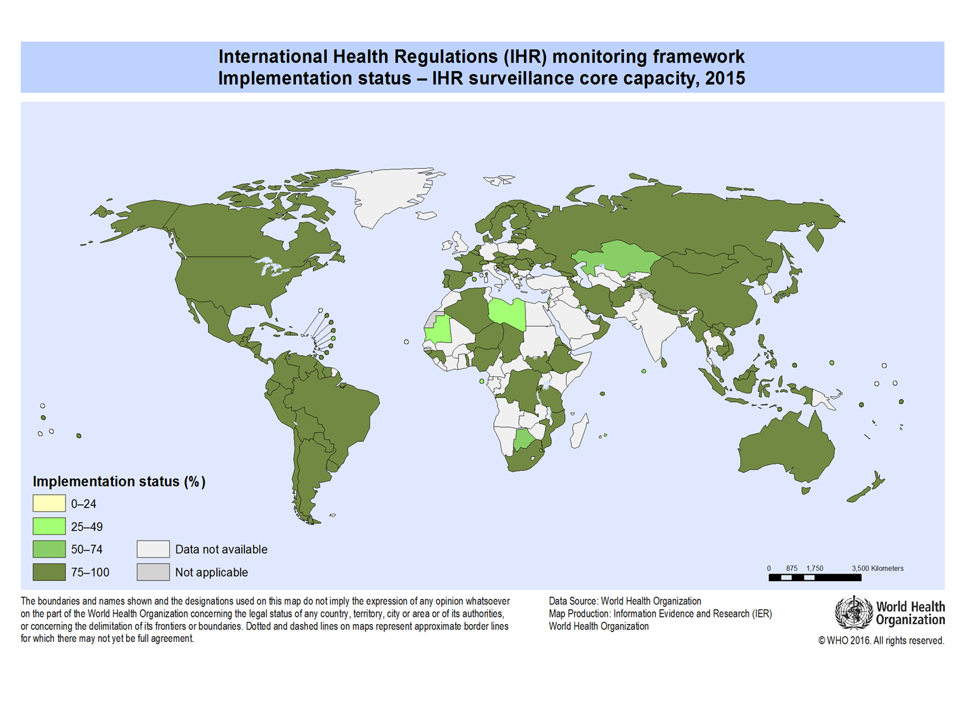
Notes:
Africa Continent is still lag behind in the implementation of IHR core capacities

Slide 9
“When your neighbor's house is on fire, your house is not safe”

Slide 10
National and Regional Public Health Institutes
International Health Partners (WHO, US CDC….)
AUC
Animal Health Networks
Other non-health sector partners
COMMON PLATFORM
INFORMATION EXCHANGE
COORDINATION & RESPONSE
MEMBER STATES
Humanitarian Organizations
Laboratory Networks in Africa
Notes:
January 2014 – Assembly decision/AU/Dec.499(XXII) of the 22nd Ordinary Session of the AU Assembly in Addis Ababa stressed an urgency to establish Africa centres for disease control and prevention – save as this platform for Member states
January 2015 – AU Heads of State and Government ratify Africa CDC concept
January 2016 – AU Heads of States and Government endorse the governing statute
May 2016 – Governing board appointed with first board meeting and Regional collaborating centres endorsed

Slide 11
Role of Africa CDC as the linkage platform
Establish continental Event Based Surveillance Unit (EBS)
Depends on focal points in Member States
Building capacity of Member States
Establish Continental Emergency Operation Centre (EOC)
Help Member States establish EOC and Incidence Management System
Regional Collaborating Centres (RCC) – Linkage to MS

Slide 12
Role of Africa CDC as the linkage platform
Help Member States in achieving IHR core capacity implementation
Mechanism for prevention, detection and response
Member States joining hands in supporting each other
Assist MS to develop surge capacity for emergency response
African Volunteer Health Corps – Build on the ASEOWA legacy
Notes:
AVOHC – proposed health volunteer corps to be launched by AUC within the Africa CDC
African Union Heads of State and Government in Decision No. Assembly/AU/Dec.570(XXV) of June 2015, requested the Commission in collaboration with Member States and Development Partners to establish an African Volunteer Health Corps to be deployed during disease outbreaks and other health emergencies and to report regularly to the Assembly on progress made.
Build on the ASEOWA legacy to roster and train public health professionals
volunteer

Slide 13
Towards Agenda 2063
In order to achieve the African Union’s vision of “An Integrated, prosperous and peaceful Africa, driven by its own citizens and representing a dynamic force in the global arena”, significantly more action is still required on a number of fronts.
Africa must do things very differently to take advantage of the current momentum towards 2063
Agenda 2063” is an approach on how the continent should effectively learn from the lessons of the past, build on the progress now underway and strategically exploit all possible opportunities available in the immediate and medium term, so as to ensure positive socioeconomic transformation within the next 50 years.
Notes:
This is a global strategy to optimize use of African’s resources for the benefits of all Africans. To achieve this Africa must do things very differently to take advantage of current momentum towards 2063, CHANGE IS INEVITABLE. W e should learn from past experience, exploit all possible opportunities available now or at medium term to bring changes in African’s health

Slide 14
Shared Vision and Mission among different actors
Africa CDC under AUC
WHO
Vision: A safer, healthier, integrated, and prosperous Africa, in which Member States can prevent disease, detect and respond together to crises of public health importance
Mission: To address priority public health concerns in Africa first through prevention and where needed, through detection and response. The Africa CDC will also serve as a platform for Member States to share knowledge, exchange lessons learned, build capacity, and provide technical assistance to each other
Vision: A safer African region where outbreaks and disasters are no longer major causes of morbidity and mortality and socio-economic disruption
Mission: Support MS to ensure health security through prevention, prediction, early warning, early detection, and, rapid and effective response emergencies and disasters including disease outbreaks, using an all-hazard approach linked to primary health care systems.
Notes:
We all share the same vision and mission however with different mandates, different strength and opportunities. A need to join our strength for a collective achievement of our goal.

Slide 15
What is needed to achieve joint continental health progress
Political will, Commitment and determination
Collective efforts
Collaboration and Partnership
Multi-disciplinary and multi-sectorial involvement in prevention, detection and response
Optimize resource utilization
Notes:
Political will, Commitment and determination to push all these agenda forward
Collective efforts among member states to achieve a common goal
Collaboration and Partnership among all key players
Multi-disciplinary and multi-sectorial involvement in prevention, detection and response
Optimize resource utilization through Effective coordination and information sharing mechanism to o

Slide 16
Next Step
AUC – Engage Member States to establish Africa CDC Focal Points
RCC – establish hosting agreements with the Africa CDC Coordinating Office
RCC – contact Member States to discuss regional emergency response coordination
Africa CDC – coordinate with WHO Global Outbreak and Alert and Response Network (GOARN) to support Member State requests for assistance

Slide 17
Thank you! Merci beaucoup
Website: www.au.int/en/africacdc Twitter: @africaCDC

