Slide 1
Public health events in the WHO Africa Region
PRC Briefing on Outbreaks and Communicable Diseases, 16 August 2016, Addis Ababa
WHO Emergency Programme, WHO Regional Office for Africa, Brazzaville, Congo

Slide 2
Overview of reported PHEs in WHO African region
Outbreaks & other health emergencies are frequent in the WHO African region
PHEs e.g. Ebola, YF, Polio, Zika, cholera… threaten regional and global health security
Disrupts societies and economies
About 100 acute public health events occur annually in the African Region
In 2015, 105 Public health events were reported.
Over 60 emergencies reported from 30 countries this year alone

Slide 3
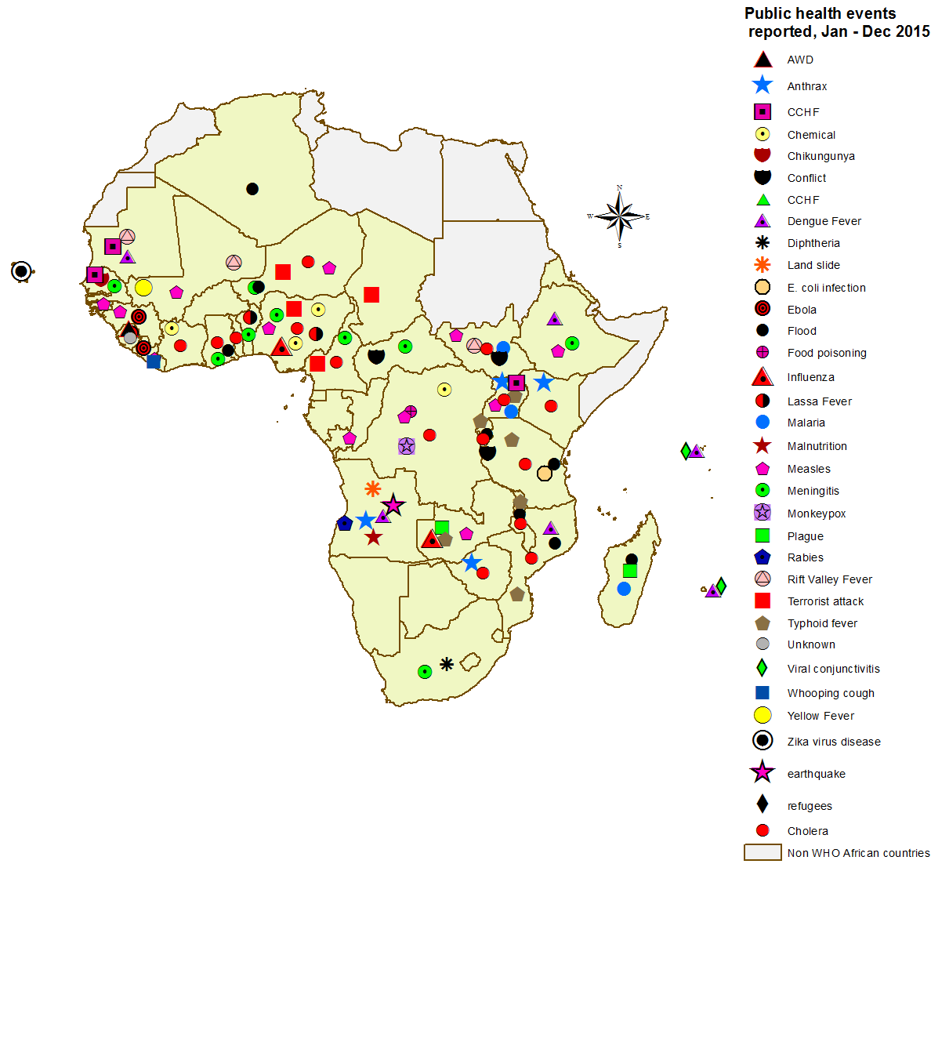
2015: public health events
82 (78%): Infectious diseases
18 (17%): Disaster
4 (4%): Chemical

Slide 4
Ongoing outbreaks

Slide 5
Yellow Fever -Angola
YF outbreak in Angola is largest in recent decades
As of 29th July, a total of 3,818 suspected cases have been reported of which 879 were laboratory confirmed
369 deaths (CFR =10%) among all suspected cases and 118 deaths (CFR =13.4%) among the confirmed cases
Laboratory confirmed cases have been reported in all the 18 provinces and in 79 out of 123 districts.
Luanda province has the majority of the confirmed cases 489 (56.8%), followed by Huambo 127 (17.7%) and Benguela 111 (12.9%)

Slide 6
Yellow Fever-DR Congo
On June 20th 2016, the Minister of health made an official statement declaring the YF outbreak a health emergency in the DRC
Five new cases of yellow fever were laboratory confirmed between 16 and 20 June 2016.
Cases were reported from Kisenso, Masina II in Kinshasa and Matadi (1 and Muanda in Kongo Central.
As of June 19, 2016 , a total of 68 confirmed cases of yellow fever have been notified, with seven (7) indigenous cases.
Daily notification of suspected cases of yellow fever is continuing

Slide 7
Yellow Fever-Uganda
The outbreak in Uganda was notified on 9 April 2016
As of 8 Jun 2016, a total of 91 cases including 3 deaths had been reported with 7 confirmed cases in three districts-Masaka (5), Rukungiri (1) and Kalangala (1)) districts
Sequencing showed a high similarity with the YF outbreak in 2010 in Northern Uganda
Uganda quickly responded and initiated reactive mass vaccination campaigns in the three districts achieving a coverage of 90.6% -96.8% in less than two weeks

Slide 8
Cholera
Fifteen countries reported a cumulative total of 97,472 cases and 1,936 deaths during the period January 2015 to 3 August 2016
Between January – 4 August 2016, a total over 30,000 cases and 400 deaths were reported in 14 out of 47 member states
Three countries accounted for 84% of all cases; DRC (35%, CFR 2%), Tanzania (30%, CFR 1.5%), and Kenya (19%, CFR 1.3%)
Humanitarian crises in CAR, South Sudan and Burundi associated with displacement of thousands of people have resulted in major health consequences
Floods and El nino affecting millions of people in eastern and Southern Africa including; Ethiopia, Zimbabwe, Malawi, Lesotho, South Africa and Zambia

Slide 9
Countries that reported cholera outbreaks to WHO January 2015 to 3 August 2016
Time period | Country | Area (s) | Cases | Deaths | CFR (%)
17 Feb-Apr’16 | Benin | Aguegues, So-Aya | 94 | 0 | 0.0
Jan ‘15– 24 July’16 | DRC | Nationwide, endemic spread to 7 new provinces (Lualaba, Maniema, Tshopo, Kinshasa, Mongala, Equateur, and Maindombe) | 33,992 | 653 | 1.9
6 Nov’15- 31 July’16 | Ethiopia | Oromia, Somali, Addis, SNNP, Afar, Amhara | 9,155 | 49 | 0.5
Jun’15-4 July’16 | Kenya | Nationwide, 2 counties active; Tana river and Mandera | 16,585 | 254 | 1.5
18Dec’15-20May’16 | Malawi | Blantyre, Karonga, Kasungu, Lilongwe, Machinga, Mangochi, Mchinji, Nkhata Bay, Phalombe, Zomba | 1643 | 43 | 2.6
Aug’15-Jan’16 | Mozambique | Nampula, Niassa, Zambezia | 1433 | 8 | 0.6
7Sept’15-Apr’16 | Nigeria | Borno, Jigawa, Kano | 1241 | 19 | 1.5
Jan’15-April’16 | Somalia | Banadir, Bay, Lower and middle Juba, Lower and middle Shabelle, & Hiraan | 7343 | 366 | 5.0
June 2015 - 1 August ‘16 | S. Sudan | Juba, Terekeka, and Duk counties in central Equatoria and Jonglei states | 679 | 21 | 3.1
21Aug’15-3 August’16 | Tanzania | Nationwide; 2 regions active, Morogoro and Zanzibar island | 22,385 | 346 | 1.5
Oct15-Feb16 | Uganda | Arua, Busia, Hoima, Kampala, Kasese, Mbale, Moroto, Sironko, Wakiso, | 1583 | 148 | 9.3
4Feb-15Jun’16 | Zambia | Lusaka, Central, Northern, Southern provinces | 1339 | 29 | 2.2
Total |  |  | 97,472 | 1936

Slide 10
Cholera Response
WHO and partners provide support to Ministries of Health in areas of;
Coordination
Surveillance including laboratory service
Case management
Logistics and supplies
WASH and social mobilization
Emphasis on multi-sectoral and multi-agency approach to effectively address causes of cholera outbreaks, often linked to;
Unsafe water, Poor food hygiene, Poor sanitation
Overall decline in trends in a number of countries including Mozambique, Malawi, Zambia, Tanzania. These gains need to be sustained

Slide 11
Issues in cholera response
Low multi-sectoral and multi-agency involvement to effectively address root causes of cholera and other water borne diseases outside mandate of Health
Water and sanitation
Food hygiene
Weak surveillance systems for early detection, confirmation and effective response to cholera outbreaks
Weak monitoring and evaluation system

Slide 12
Priority Actions -Cholera-1
Strengthen and sustain capacity of member states through a Regional strategy;
Prevent outbreaks and other health emergencies
Reduce morbidity, mortality, disability and socio-economic disruptions due to PHEs including cholera by prompt;
detection and confirmation of outbreaks
Response to and recovery from negative effects of PHEs
High level advocacy for strong multi-sectoral and multi-agency strategy to effectively address root causes of cholera and other water borne diseases (water & sanitation, Food hygiene)

Slide 13
Priority Actions -Cholera-2
Conduct joint process reviews to assess bottlenecks to cholera outbreak response
Countries where cholera outbreaks have been controlled, need to conduct after-outbreak response review to identify lessons learnt and best practices, risk profiling using the all hazard approach and review contingency plans accordingly
Maintain cholera as standing item on the Multi-sectoral national and provincial/district outbreak response committees monthly meetings
Cholera preparedness plans should be implemented 1-2 months before onset of another season
Need for strong monitoring and evaluation system and use of data for action

Slide 14
Chikungunya-Kenya
Started in the 1st week of May 2016
MOH reported to WHO on 28 May 2016
As of 14 June 2016, 1,394 cases with 0 death had been reported from the Mandera County
Of the 82 samples tested, 25 were positive for Chikungunya virus by KEMRI Arboviral laboratory in Nairobi

Slide 15
We need a regional strategy to guide member states & partners
Vision: A safer African region where outbreaks and disasters are no longer major causes of morbidity and mortality and socio-economic disruption
Mission: Support MS to ensure health security through prevention, prediction, early warning, early detection, and, rapid and effective response emergencies and disasters including disease outbreaks, using an all-hazard approach linked to primary health care systems.
Goal: To minimize the public health and socio-economic impact of outbreaks, emergencies and disasters, in the African Region

Slide 16
Objectives
To strengthen and sustain the capacity of all the Member States health systems to prevent outbreaks and other health emergencies
To strengthen and sustain the capacity of all the Member States health systems to promptly detect and confirm outbreaks
To strengthen and sustain the capacity of all the Member States health systems to promptly respond to and recover from the negative effects of outbreaks and health emergencies

Slide 17
Targets -1
At least 80%, of Member States have organized a joint external evaluation (JEE) of IHR core capacities by 2018.
At least 80%, of Member States have all hazards preparedness plans that are reviewed and tested, by 2018.
At least, 80% of the Member States will have the minimum IHR core capacities, by 2020.
Over 90%, of Member States are implementing IDSR including event-based surveillance systems with at least 90% country coverage, by 2020.
At least 80% of Member States have a functional national laboratory system and network by 2020

Slide 18
Targets-2
Over 90% of Member States have a multi-level and multi-faced risk communication strategy for real time exchange of information, by 2020.
Over 80% of Member States will have an adequate health work force to respond to outbreaks and health emergencies as stipulated in the JEE tool by 2020

Slide 19
Strategic Approaches
All-hazard approach – one operational platform , One Health, new WHE
The RAPID concept:
Rapid response for rapid impact
Actions and results oriented
Proactive Preparedness and Prevention
Intelligence and real-time information, risk mapping and communication for rapid decision making
Dedicated staff and team including across clusters

Slide 20
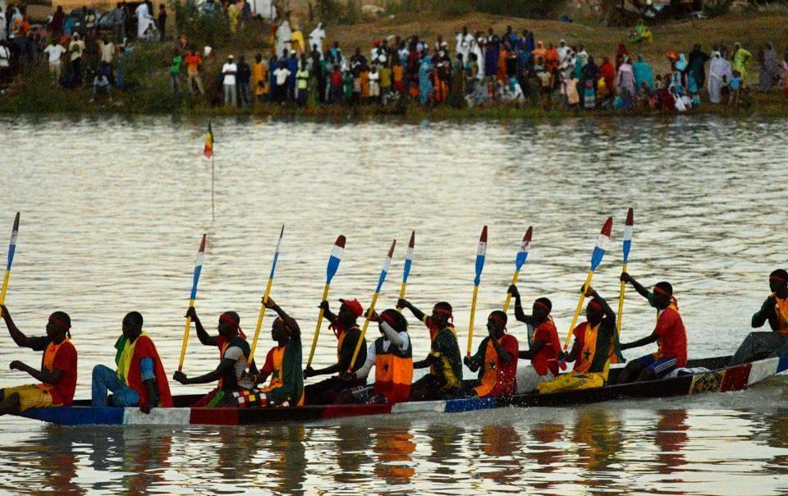
Dedicated work force at all levels

Slide 21
Priority Strategic actions-1
Conduct regional risk-mapping for PHEs to build early warning and response systems
Establish regional capacity for strategic information management for decision making
AMR surveillance and mitigation
High level advocacy meetings for IHR including other sectors in collaboration with RECs
Revitalize African Public Health Fund
Build country IHR core capacities in a coordinated manner in the context of GHS-better partners 'coordination

Slide 22
Priority Strategic actions-2
Implementation of the “one health approach” and AMR; advocacy for improved stock pile of vaccines-YF, meningitis, OCV
Strengthening IHR core capacities in low and middle income countries linked to district health system strengthening
Early warning system, district and community surveillance using eSurveillance and real-time information
Building laboratory capacities, biosafety and strengthening of Infection Prevention and Control (IPC) - Experts deployment during emergencies

Slide 23
Partnerships, Collaboration & Advocacy
Enhanced advocacy for IHR & GHS capacity building in context of WHO emergency reform
Establish a regional partnership forum for “One health” to serve as a platform for coordinated action, mobilizing resources and forging consensus among partners and Member States
Facilitate partnerships to improve preparedness, alert and response and strengthen cross-country and cross-institutional collaboration.
Strengthen national and regional networks of Research Institutes to support Member States to conduct research
Establish a regional health workforce to promptly respond to outbreaks and health emergencies.
Collaboration with the Africa CDC and coordination of new initiatives

Slide 24
What the world expects of WHO in emergencies?
1
Single approach for all emergencies (outbreaks, disasters, etc)
2
Standardized across all 3 levels & all 7 major offices
3
Leverage & facilitate UN, partners & disaster mgmt systems
4
Optimize WHO political access & technical expertise
Operate across the emergency management cycle
5

Slide 25
WHO’s new Health Emergencies Programme
One emergency programme
'A quicker, predictable, dependable, & capable WHO in support of people at
risk of, or affected by, emergencies'
One workforce
One budget
One line of accountability
One set of processes/systems
One set of benchmarks

Slide 26
All hazards approach
Hazard
Event
Chemical
Spill
Radiation
Leak
Infectious Hazards
(e.g H5N1, H7N9, coronaviruses, filoviruses)
Infectious risk
grading & mgmt
Event Grading & Response
Infectious
RESPONSE
Outbreak
Natural disaster
Event
Conflict
War
Infectious Hazard Managment
Emergency operations

Slide 27
WHO's Roles in Health Emergency Risk Management
Infectious Hazard Management
IHR & Member State Preparedness
Risk Assessment & Health Emergency Info/Data
Emergency Operations
Incident management
Protracted crises planning
Operational Partners & Readiness
Operations Support & Logistics

Slide 28
A financially empowered & sustainable WHO Health Emergencies Programme
Adequate financing is a prerequisite for success in supporting of Member State preparedness strengthening
The financial viability and sustainability of the new programme requires a combination of core financing for WHO’s standing emergency risk management capacity and normative work
Also required is a contingency fund (CFE) for rapidly initiating and enabling new emergency response operations

Slide 29
Conclusion
We need to collectively act now to stop the loss of African lives
We need robust surveillance to nip epidemics and health emergencies in the bud
We need to build world class infrastructure to prevent, detect, and respond to outbreaks and other health emergencies
New WHE programme offers us an opportunity

Slide 30
Thank You

