Slide 1
Inclusivity
“The current situation and identify key strategies and approaches to enhance inclusivity in ICT and E-commerce”
African Union E-Commerce Conference
James Howe
Senior Adviser, Marketing, Branding and E-Commerce
24th July 2018

Slide 2
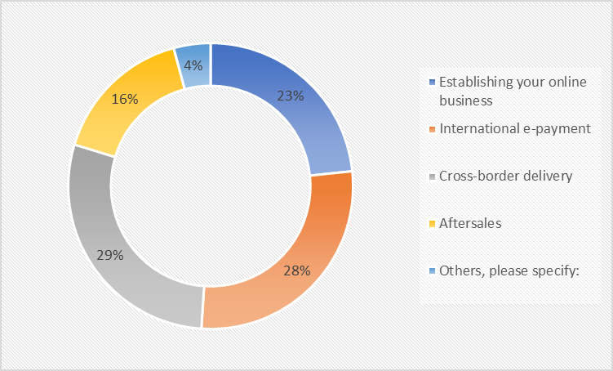
Main bottlenecks are in cross-border delivery and e-payment
Assessment of overall challenges in the e-commerce chain
34% for Africa: more challenges with E-payment

Slide 3
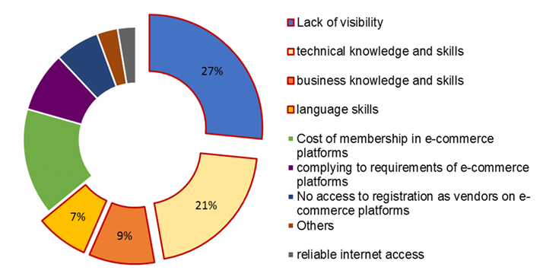
Bottleneck #1: knowledge, skills and visibility
37% → lack of knowledge and skills
(similar figure for Africa)

Slide 4
(Some) Dimensions of inclusivity
Gender
Youth
Rural
82% of respondents that engage solely in cross-border e-commerce are micro and small in size

Slide 5
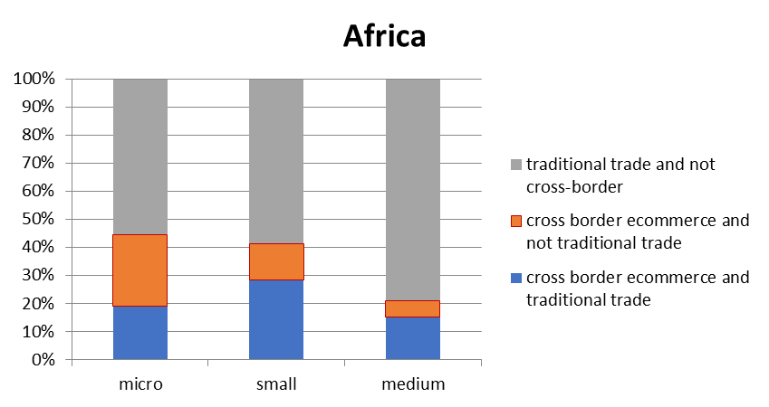
E-commerce provides opportunities for micro firms in Africa to start trading
Companies in Africa that started trading thanks to e-commerce
Notes:
In Africa, the share of companies that started trading because of E-commerce is largest among micro-firms which again shows that e-commerce opens doors to trade especially for MSMEs

Slide 6
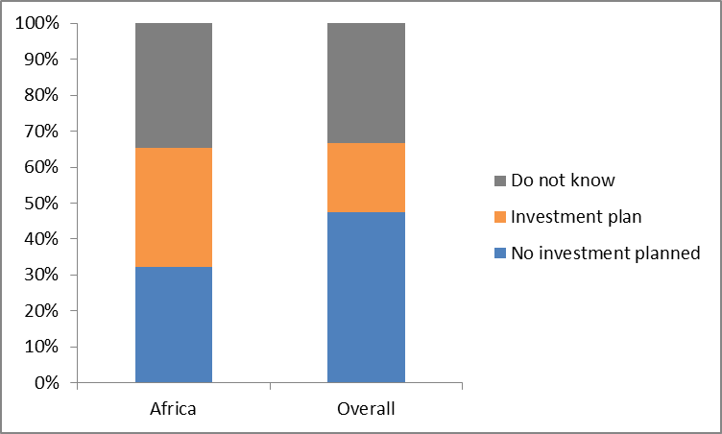
African companies have higher interest to invest in e-commerce A third of the respondents from Africa have plans to (further) invest in e-commerce in the next three years.

Slide 7
The programme
Online listing
Online payments
Preparing for e-fulfilment
Online promotion
Etc.
Technologies to prepare for the creation of e-commerce platforms with shared access to payments, logistics and marketing solutions
Access to international legal and fiscal support
Partnerships with some of the world’s leading logistics, e-commerce and online payments firms
Training
Technologies
Advisory
Partners

Slide 8
Example ITC e-commerce projects
Establishing a formal commercial presence in Europe to enable Moroccan sellers to receive international payments and correctly handle duties and domestic taxes.
Helping young entrepreneurs in Senegal to reach buyers around the world with the launch of an online platform that will connect with global e-commerce marketplaces
Locally-managed B2B online marketplace / directory across 8 countries
Morocco (2015/2016)
Senegal (2017)
Connect UEMOA (2017-)
Setting up export arrangements for handicrafts from Syria to connect internally displaced women artisans to global markets
Helping young entrepreneurs in Senegal to reach buyers around the world with the launch of an online platform that will connect with global e-commerce marketplaces
Boost understanding among small firms and service partners in Rwanda of what it takes to succeed in e-commerce; Enabling access to markets and providing firms the tools and support to trade online
Syria (2017)
Asian LDCs (2017)
Rwanda (2017-2019):
+ 2018: Central America (Women handicraft producers), Central Asia, Qatar

